Slide 1
How dynamic Power Tariffs Influence DemAND RESPONSE
Contrasting estimates of system-wide demand response potentials with their micro-economic assessment

Slide 2
Research questions How high are potentials and how do they perform for different power tariffs?
Overall power system
Microeconomic assessment
How high are the potentials for demand response in the power sector for mostly „classical“ applications?
Are investments in demand response economically viable for given power tariffs designs?
studied for different system assumptions, i. e. cost-relations of flexibility options & technical demand response potentials
studied for different power tariffs varying in
share that is dynamic (i.e. varying with the day-ahead power price)
split between capacity- and energy- related payments
Notes:
Dynamic nicht erklären

Slide 3
Method 1: Potential study using a fundamental power market model Utilizing the power market modelling suite POMMES
pommesdata
https://github.com/pommes-public/pommesdata
data for power plants, RES, storage, costs data & technology assumptions
deriving scenarios based on latest literature, e.g. “big 5” studies [3-7]
technical demand response potentials based on [8-9]
Data preparation & scenario generation
1
pommesinvest
https://github.com/pommes-public/pommesinvest
multi-period capacity expansion and dispatch from 2020 to 2045
implemented using / extending oemof.solph
demand response implementation based on Gils (2015) [10]
Investment model run
2
Analysis & transformation of model results
pommesevaluation
https://github.com/pommes-public/pommesevaluation
ex post analyses: plotting, statistics / metrics etc.
converter to agent-based power market model AMIRIS‘ inputs
3
Notes:
[3] Prognos, Öko-Institut, Wuppertal-Institut (2021): Klimaneutrales Deutschland 2045. Wie Deutschland seine Klimaziele schon vor 2050 erreichen kann. Studie im Auftrag von Agora Energiewende, Agora Verkehrswende und Stiftung Klimaneutralität.
[4] BCG (2021): Klimapfade 2.0 – Ein Wirtschaftsprogramm für Klima und Zukunft. Studie im Auftrag des BDI.
[5] EWI, FIW, ITG, Uni Bremen, Stiftung Umweltenergierecht, Wuppertal-Institut (2021): dena-Leistudie Aufbruch Klimaneutralität. Eine gesamtgesellschaftliche Analyse.
[6] Consentec, Fhg- ISI, TU Berlin, ifeu (2021): Langfristszenarien für die Transformation des Energiesystems in Deutschland 3. Studie im Auftrag des BMWK.
[7] PIK, MCC, PSI, RWI, IER, Hereon, Fraunhofer ISI, Fraunhofer ISE, Fraunhofer IEG, Fraunhier IEE, DLR-VF, DLR-VE, DLR-FK (2021): Deutschland auf dem Weg zur Klimaneutralität 2045. Studie im Rahmen des Kopernikus-Projekts Ariadne. [8] Kochems, Johannes (2020): Lastflexibilisierungspotenziale in Deutschland – Bestandsaufnahme und Entwicklungsprojektionen, Langfassung: In: Tagungsband 16. Symposium Energieinnovation, 12.-14.02.2020, Graz.
[9] Kochems, Johannes (2020): Demand response potentials for Germany: potential clustering and comparison of modeling approaches, presentation at the 9th INREC Conference.
[10] Gils, Hans Christian (2015): Balancing of Intermittent Renewable Power Generation by Demand Response and Thermal Energy Storage, Dissertation, Universität Stuttgart.

Slide 4
Method 2: Assessing microeconomic profitability Utilizing the agent-based power market model AMIRIS
Power tariff design
4
5
starting point: current payment obligation for a given load shifting focus cluster
variation of
share of the dynamic energy tariff
split between energy and capacity tariff
6
Assessment of profitability using annuities
load shifting implementation also based on Gils (2015) [10]
seeking to minimize power payment obligations of focus cluster
Overall goal: annuity ≈ 0
Interpretation: system optimal investment choices are economically viable
https://gitlab.com/dlr-ve/esy/amiris/amiris

Slide 5
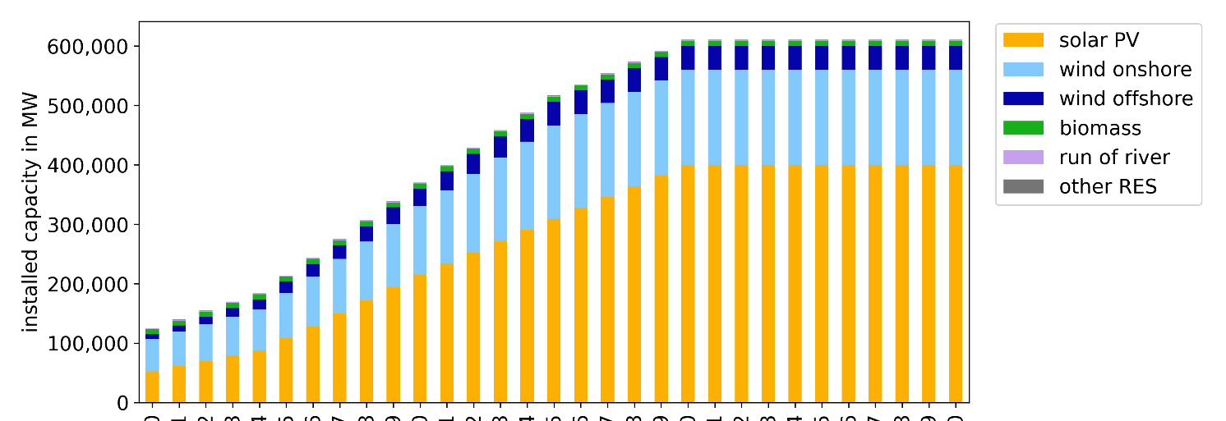
Main assumptions across the scenarios Reaching a climate-neutral power sector by 2035 with current expansion & decommissioning plans
Renewables (exogenous)
Important premise
brownfield approach considering
current planning and
state of legislation!
Backup
(exogenous)
Data sources: [11-24]
Notes:
[11] EEG 2023: Weitere Änderungen des Erneuerbare-Energien-Gesetzes, Artikel 2 des Gesetzes zu Sofortmaßnahmen für einen beschleunigten Ausbau der erneuerbaren Energien und zu weiteren Maßnahmen im Stromsektor vom 20. Juli 2022, BGBl. I, S. 1237.
[12]: Open Power System Data (2020) Data Package Conventional power plants. Version 2020-10-01, downloaded on 2021-01-04. https://doi.org/10.25832/conventional_power_plants/2020-10-01
[13] NEP power plant list: ÜNB / BNetzA (2019): Kraftwerksliste zum ÜNB Entwurf des Szenariorahmens zum NEP 2030, https://www.netzentwicklungsplan.de/sites/default/files/paragraphs-files/Kraftwerksliste_%C3%9CNB_Entwurf_Szenariorahmen_2030_V2019_2_0_0.pdf, downloaded on 2019-10-22.
[14] UBA (2019): Genehmigte oder im Genehmigungsverfahren befindliche Kraftwerksprojekte in Deutschland, as of 01/2019, https://www.umweltbundesamt.de/sites/default/files/medien/384/bilder/dateien/4_tab_genehmigte-in_genehmigung-kraftwerksprojekte_2019-04-04.pdf, accessed 03.11.2020.
[15] BDEW (2019): BDEW-Kraftwerksliste. In Bau oder Planung befindliche Anlagen ab 20 Megawatt (MW) Leistung, Anlage zur BDEW-Presseinformation vom 1.April 2019 zur Hannover Messe, https://www.bdew.de/media/documents/PI_20190401_BDEW-Kraftwerksliste.pdf, accessed 03.11.2020.
[16] BNetzA (2020): Kraftwerksliste Bundesnetzagentur zum erwarteten Zu- und Rückbau 2019 bis 2022, https://www.bundesnetzagentur.de/DE/Sachgebiete/ElektrizitaetundGas/Unternehmen_Institutionen/Versorgungssicherheit/Erzeugungskapazitaeten/Kraftwerksliste/kraftwerksliste-node.html, as of 01.04.2020, accessed 05.01.2021.
[17] Egerer, Jonas, Gerbaulet, Clemens, Ihlenburg, Richard, Kunz, Friedrich, Reinhard, Benjamin, Hirschhausen, Christian von, Weber, Alexander, Weibezahn, Jens (2014): Electricity Sector Data for Policy-Relevant Modeling: Data Documentation and Applications to the German and European Electricity Markets, DIW and TU Berlin, WIP, DIW Data Documentation 72, Berlin, March 2014. © DIW Berlin, 2014.
[18] BNetzA (2020): Kraftwerksstilllegungsanzeigenliste, as of 15.04.2020, https://www.bundesnetzagentur.de/DE/Sachgebiete/ElektrizitaetundGas/Unternehmen_Institutionen/Versorgungssicherheit/Erzeugungskapazitaeten/KWSAL/KWSAL_node.html, accessed 05.01.2021.
[19] AtG: https://www.gesetze-im-internet.de/atg/, accessed 03.11.2020.
[20] KVBG: https://www.gesetze-im-internet.de/kvbg/, accessed 03.11.2020.
[21] BNetzA (2022): Kohleausstieg, Ausschreibungen, https://www.bundesnetzagentur.de/DE/Fachthemen/ElektrizitaetundGas/Kohleausstieg/start.html, accessed 27.05.2022.
[22] Demand Regio disaggregator. https://github.com/DemandRegioTeam/disaggregator.
[23] ENTSO-E (2022): Transparency Platform, Actual Generation per Production Type, https://transparency.entsoe.eu/generation/r2/actualGenerationPerProductionType/show, acessed 04.02.2022.
[24] AMIRIS Germany Example: https://gitlab.com/dlr-ve/esy/amiris/examples/-/tree/main/Germany2019, accessed 01.03.2022.

Slide 6
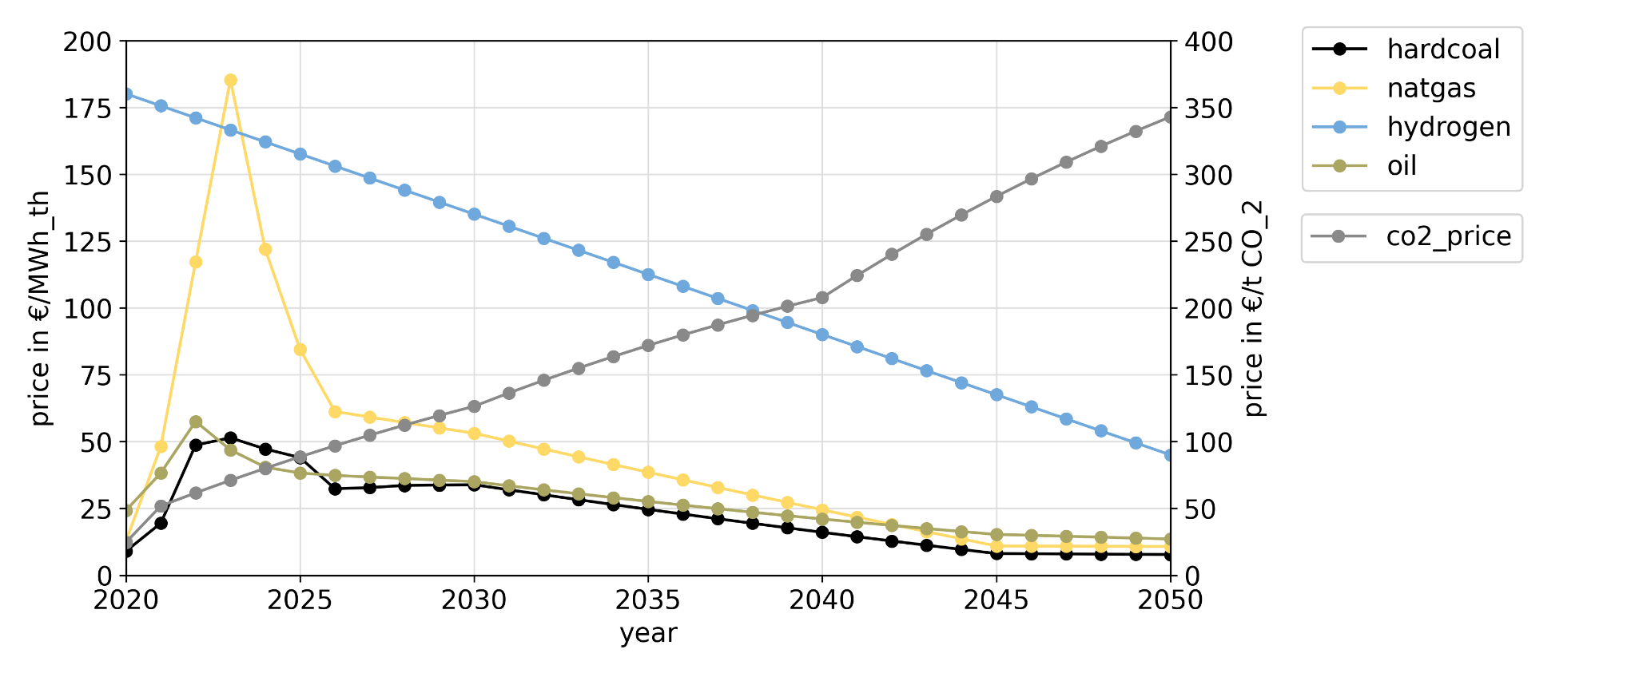
Main assumptions across the scenarios Reaching a climate-neutral power sector by 2035 considering a short-term fuel price shock
Fuel and emissions prices
(in real terms for 2020)
Data sources: [17]; [25-35]
Notes:
[17] Egerer, Jonas, Gerbaulet, Clemens, Ihlenburg, Richard, Kunz, Friedrich, Reinhard, Benjamin, Hirschhausen, Christian von, Weber, Alexander, Weibezahn, Jens (2014): Electricity Sector Data for Policy-Relevant Modeling: Data Documentation and Applications to the German and European Electricity Markets, DIW and TU Berlin, WIP, DIW Data Documentation 72, Berlin, March 2014. © DIW Berlin, 2014.
[25] IEA (2021): World Energy Outlook 2021.
[26] BMWK (2022): Energiedaten. Gesamtausgabe, as of 20.01.2022, https://www.bmwi.de/Redaktion/DE/Artikel/Energie/energiedaten-gesamtausgabe.html, accessed 25.02.2022.
[27] EWI (2022): Szenarien für die Preisentwicklung von Energieträgern. Endbericht. Im Auftrag des Akademienprojekts „Energiesysteme der Zukunft“ (ESYS). Juli 2022.
[28] Natural Gas: OTC Prices for THE, provided by Methanology, Calendar 2023-2025 (values in €/MWh), trading dates 03.01.2022 - 09.09.2022.
[29] Hard coal: OTC Prices for API#2 (Amsterdam, Rotterdam, Antwerpen), provided by Spectron (values in USD/t), trading dates 03.01.2022 - 09.09.2022.
[30] Oil: Exchange Prices for Crude Oil Brent, provided by ICE (values in USD/bbl), trading date 13.09.2022.
[31] IEA (2020): Global average levelised cost of hydrogen production by energy source and technology, 2019 and 2050, https://www.iea.org/data-and-statistics/charts/global-average-levelised-cost-of-hydrogen-production-by-energy-source-and-technology-2019-and-2050, accessed 02.09.2022.
[32] Brändle, Georg, Schönfisch, Max, Schulte, Simon (2020): Estimating Long-Term Global Supply Costs for Low-Carbon Hydrogen, EWI Working Paper, No 20/04, November 2020, https://www.ewi.uni-koeln.de/cms/wp-content/uploads/2021/03/EWI_WP_20-04_Estimating_long-term_global_supply_costs_for_low-carbon_Schoenfisch_Braendle_Schulte-1.pdf, accessed 02.09.2022.
[33] EEX (2017-2021): Emission Spot Primary Market Auction Report 2017-2021, https://www.eex.com/en/market-data/environmental-markets/eua-primary-auction-spot-download, accessed 28.02.2022.
[34] Pietzcker, Robert, Knopf, Brigitte, Osorio, Sebastian, Edenhofer, Ottmar et al. (2021): Ariadne-Hintergrund. Notwendige CO2-Preise zum Erreichen des europäischen Klimaziels 2030, issued by PIK, November 2021, https://doi.org/10.48485/pik.2021.007.
[35] Pietzcker, Robert, Osorio, Sebastian, Rodrigues, Renato (2021): Tightening EU ETS targets in line with the European Green Deal: Impacts on the decarbonization of the EU power sector, in: Applied Energy 293 (2021), https://doi.org/10.1016/j.apenergy.2021.116914.

Slide 7
Main assumptions across the scenarios Reaching a climate-neutral power sector by 2035 studying investments in the remaining options
Investment options
backup plants (no CCS)
natural gas
hydrogen
biomass
oil peakers
storages
pumped hydro energy storage
(lithium-ion) batteries
electrolyzers
demand response
for households
industrial
commercial
Parameterization
30 primary sources from [8] for demand response
[35-39] for remaining options
Notes:
[8] Kochems, Johannes (2020): Lastflexibilisierungspotenziale in Deutschland – Bestandsaufnahme und Entwicklungsprojektionen, Langfassung: In: Tagungsband 16. Symposium Energieinnovation, 12.-14.02.2020, Graz.
[35] Pietzcker, Robert, Osorio, Sebastian, Rodrigues, Renato (2021): Tightening EU ETS targets in line with the European Green Deal: Impacts on the decarbonization of the EU power sector, in: Applied Energy 293 (2021), https://doi.org/10.1016/j.apenergy.2021.
[36] Fraunhofer ISE (2020): Appendix to the study "Wege zu einem klimaneutralen Energiesystem. Die deutsche Energiewende im Kontext gesellschaftlicher Verhaltensweisen.", https://www.ise.fraunhofer.de/de/veroeffentlichungen/studien/wege-zu-einem-klimaneutralen-energiesystem.html, accessed 08.07.2022.
[37] PyPSA-EUR assumptions on costs compiled from various (primary) sources: https://github.com/PyPSA/pypsa-eur/blob/master/data/costs.csv, accessed 01.07.2022.
[38] dieterpy input data compiled from various (primary) sources: https://gitlab.com/diw-evu/dieter_public/dieterpy_reduced/-/blob/main/input/data_input.xlsx, accessed 01.07.2022.
[39] Data set from the research project FlexMex, https://zenodo.org/record/5802178, including data compiled from various (primary) sources, accessed 01.07.2022.
[40] Collection of data from various (primary) sources from the research project UNSEEN (as of 03/2021).

Slide 8
Scenario design Considering one scenario without and three scenarios with demand response
 | no DR (DR none) | DR pessimistic (DR 5) | DR neutral (DR 50) | DR optimistic (DR 95)
Demand response (DR) prevalent?
Costs of DR
technical potential of DR
Costs of other flexibility options
DR: Demand Response

Slide 9
Power tariff designs considered 31 power tariff designs – varying in the dynamic share and the capacity / energy split
Price patterns for different dynamic shares
dynamic share of energy tariff capacity tariff share | 0 | 20 % | 40 % | 60 % | 80 % | 100 %
0
20 %
40 %
60 %
80 %
100 %

Slide 10
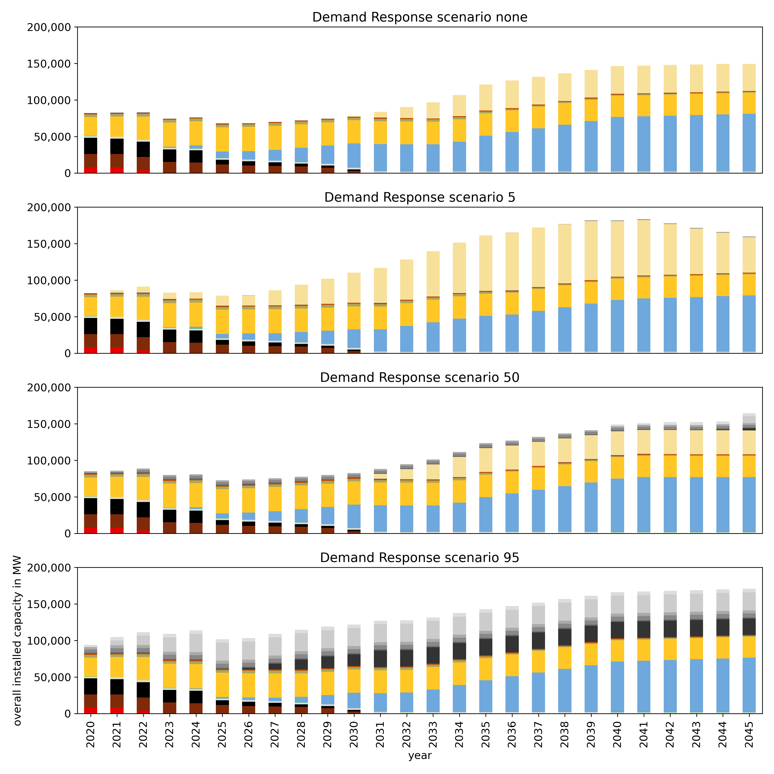
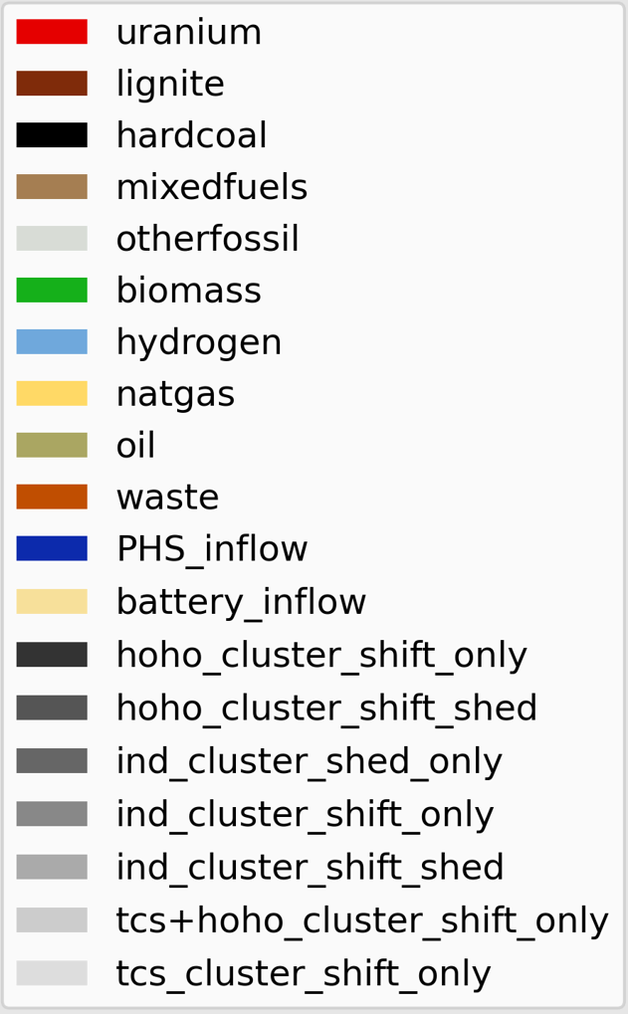
Preliminary results: Total installed capacities of flexibility options Large amount of flexibility resources with hydrogen and storages dominating
Findings
Cost-relations are well reflected in investment choices.
Around 75 - 80 GW of usable (!) secured capacity from hydrogen in 2045 with phase in starting in mid-2020s.
Preliminary results!
Only indicating trends

Slide 11
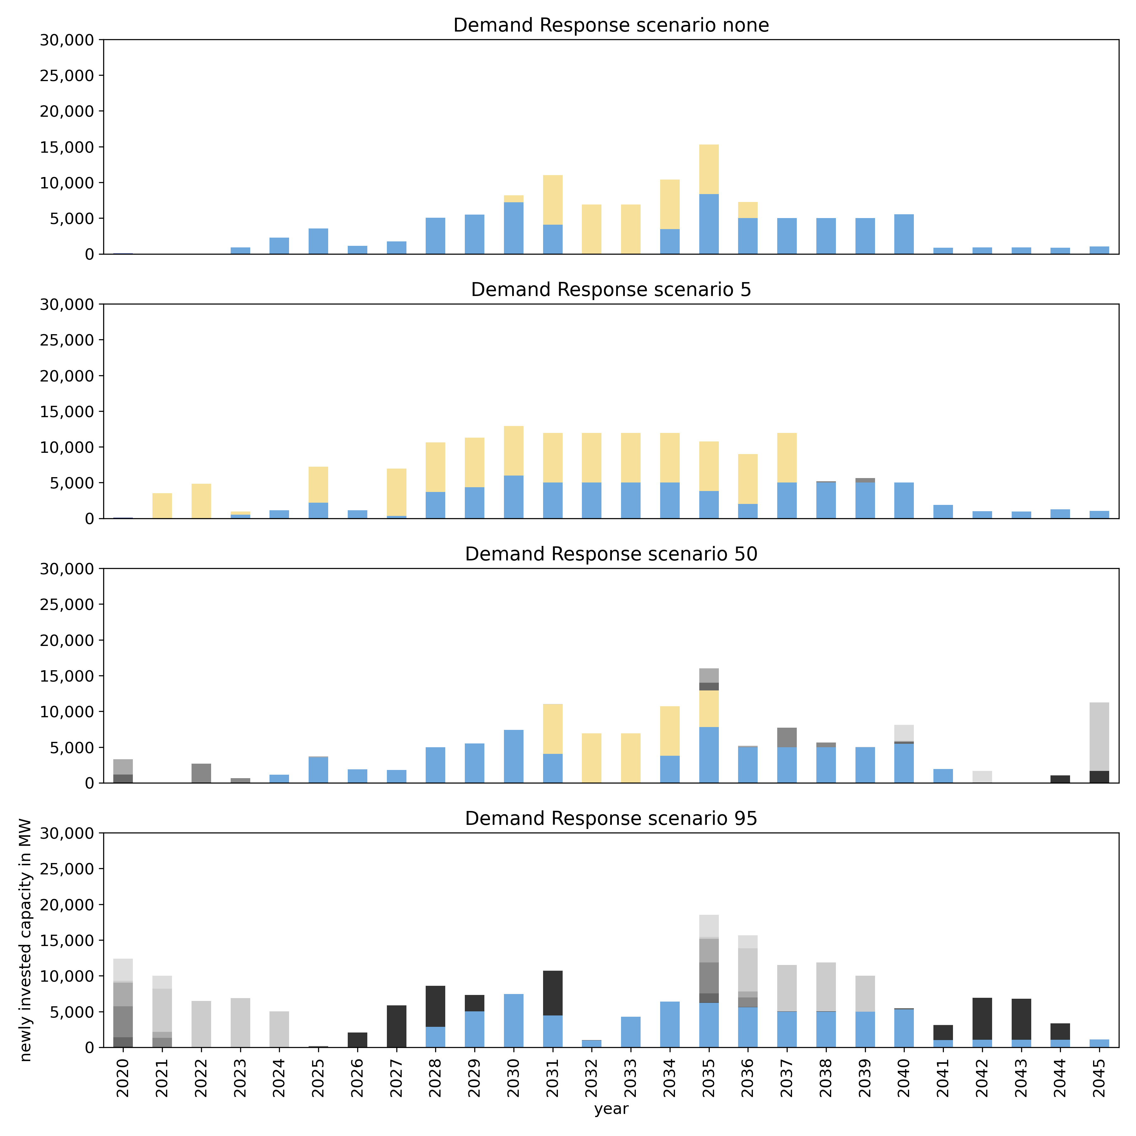
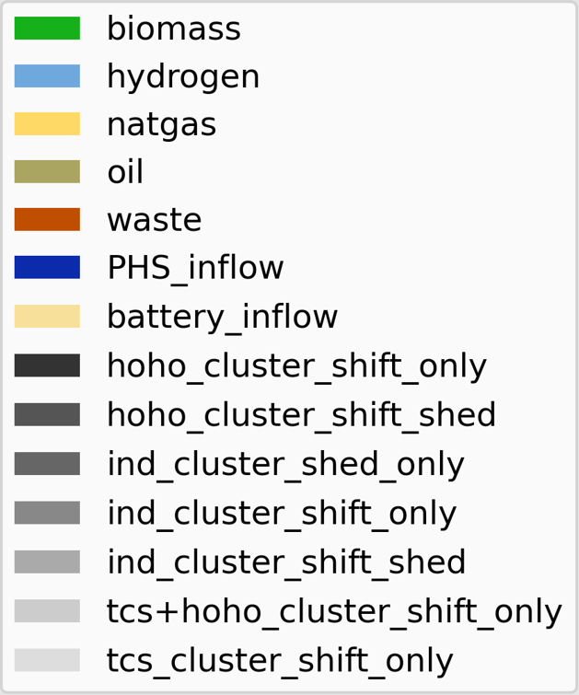
Preliminary results: Investments in demand response Strong deviation between the scenarios, but large investments when demand response is allowed
total demand response investments: 0.8 GW (almost entirely industrial consumers)
total demand response investments: 23.3 GW (of which 9.6 GW from household & tcs heat pumps and cooling)
increasing utilization of demand response
total demand response investments: 63.2 GW (of which 24.6 GW from household & tcs heat pumps and cooling)
Preliminary results!
Only indicating trends

Slide 12
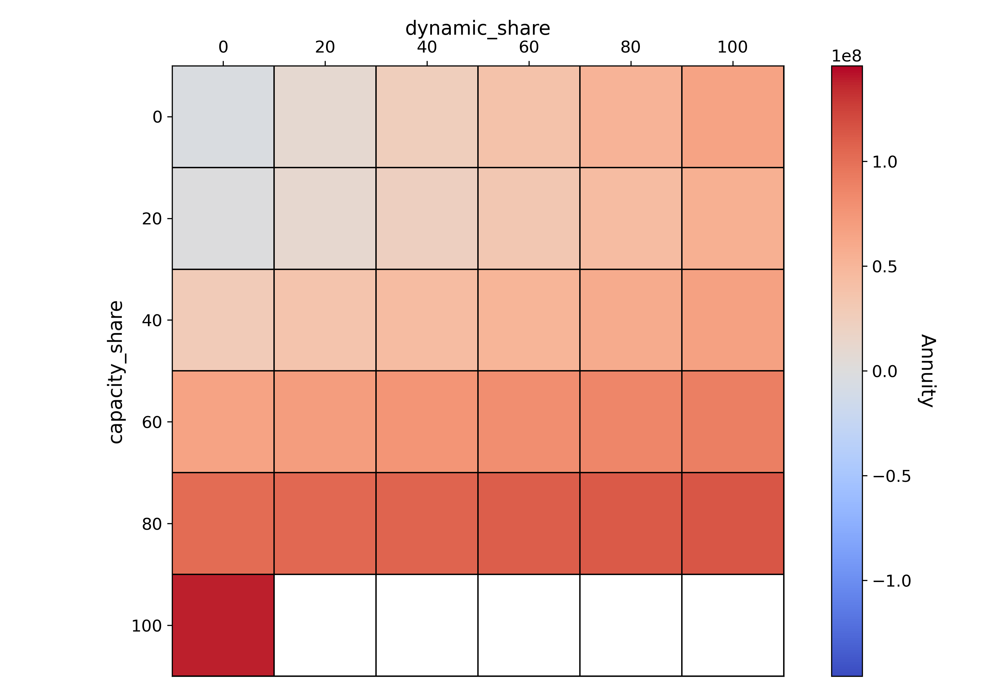
Preliminary results: Microeconomic profitability Keeping dynamic & capacity tariff shares small seems preferable from a system point of view
Load shifting is profitable
while not overincentivized
Preliminary results!
Only indicating trends

Slide 13
Conclusion and Outlook
Findings
Outlook
System-wide demand response potential from <1 up to >60 GW depending on cost-relations.
Improve robustness and look at generalizability
Refine parameterization and study parameter variations
Analyse space between discrete tariff models
1
Higher dynamic and capacity shares create strong incentives for using demand response.
2
Preliminary results indicate that there is a thread of over-incentivizing flexibility.
3

Slide 14
Thank you!
M.Sc. Johannes Kochems
Research Associate
Mail: johannes.kochems[at]dlr.de
Phone: +49 711 6862 8521
Deutsches Zentrum für Luft- und Raumfahrt e. V. (DLR)
German Aerospace Center
Institute of Networked Energy Systems | Energy Systems Analysis | Curiestraße 4 | 70563 Stuttgart | Germany
DLR.de/ve
Acknowledgements
Many thanks to
Christoph Schimeczek for co-development of AMIRIS model parts.
Yannick Werner for co-development of general data routines.
Manuel Wetzel for support with the HPC cluster infrastructure.
Kristina Nienhaus for valueable hints.
Prof. Dr. Joachim Müller-Kirchenbauer for his guidance.
EU Commission for funding of recent work.

Slide 15
Impressum
Topic: How dynamic Power Tariffs Influence Demand response. Contrasting system-wide demand response potential estimates with their micro-economic assessment.
Date: 16.02.2023
Author: Johannes Kochems
Institute: Institute of Network Energy Systems (DLR-VE)
Images: All images „DLR (CC BY-NC-ND 3.0)“ if not stated otherwise

