Slide 1
Modeling the technical and economic feasibility of district cooling networks
IEWT, 2023
17.02.2023
Presenter:
Aadit Malla
EEG, TUW

Slide 2
Contents
Motivation and Research Question
Methodology
Assumptions
Test Case Vienna - Results
Conclusion
Outlook

Slide 3
Motivation
Increasing cooling demand
District Cooling has the potential to provide an economic and sustainable cooling solution under different demand development scenarios
District Cooling’s better opportunity for RE integration
The lack of models/tools for a techno-economic evaluation of the District Cooling Network potential
Research Question
How feasible are District Cooling networks considering the pumping and pipe costs under baseline demand conditions?

Slide 4
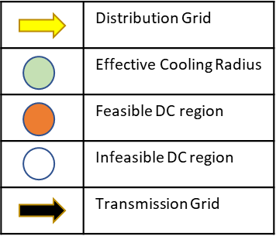
Methodology
Road Distribution
Cooling Degree Days
Defining the anchor
Estimation of the average pipe diameter, system costs
Comparison of the system costs with decentral/ individual cooling supplies
Identify feasible locations and demand share coverage potential from DC networks
Assess the feasibility of the network expansion
Understand the sensitivity to electricity prices
Gross Floor Area
Theoretical Useful Energy Demand

Slide 5
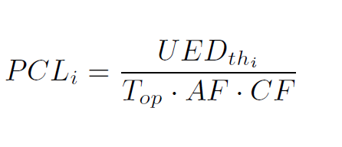
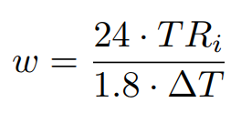
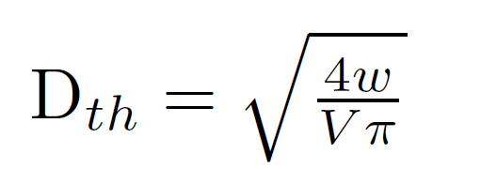
Model
Estimation of the Peak Cooling Load per cell [1]
Calculating the Volume Flow rate (w) and Theoretical Diameter [2]
Calculating the Grid Costs
Calculating the Grid Costs
[1] Li et.al., A life cycle analysis techno-economic assessment framework for evaluating future technology pathways, 2021
[2]Lisaba et.al., Pipe sizing of district cooling distribution network including in energy transfer station, 2021

Slide 6
Assumptions
30% of the Theoretical Useful Energy Demand is met at the current state. The spatial distribution of the cooling supply is randomly distributed
Both Trench and pipe costs are considered for the estimation of the grid investment costs
Additional costs for connecting the pipes to the individual buildings within the cells are not considered
No Existing Cooling grids are considered.
Operation electricity prices of District cooling is not considered yet.

Slide 7
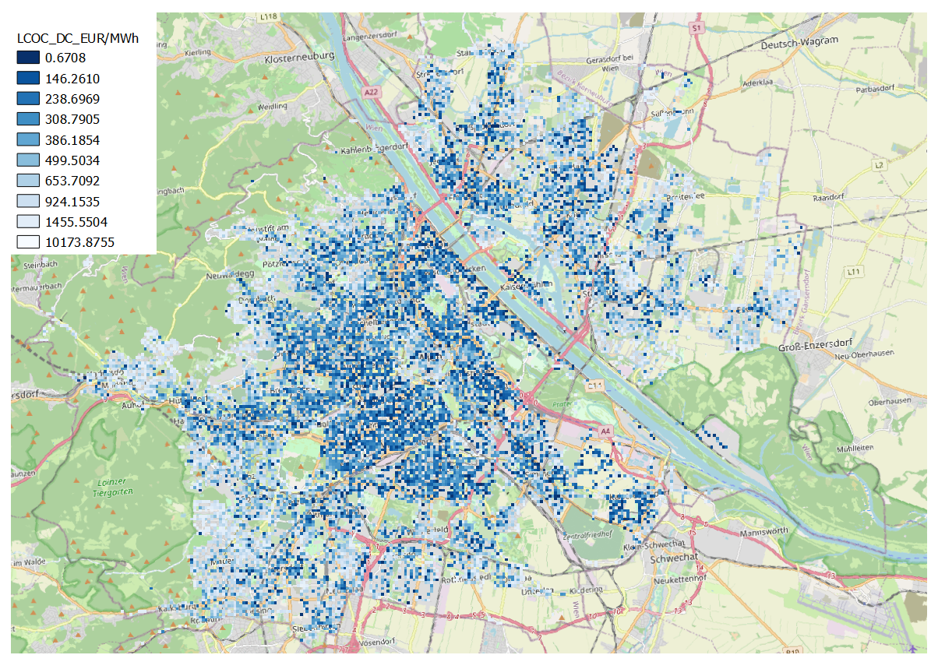
Test Case Vienna
Input
Theoretical Useful Energy Demand (HOTMAPS)
Gross Floor Area (HOTMAPS)
Cooling Degree Days (HOTMAPS)
Secondary and Tertiary Road lengths (OSM)
Electricity Price

Slide 8
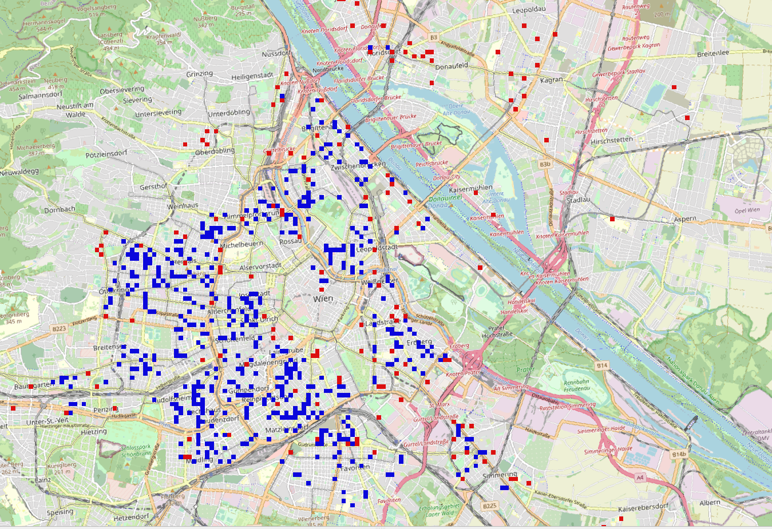
Definition of the Anchor
 | Assumption 1 | Assumption 2
Anchor Definition | Highest 25% energy demand Lowest 25% GFA Peak Demand > 1 | Highest 25% energy demand Highest 25% GFA Peak Demand > 1
Demand Covered (GWh.) | 75 | 360
% of Demand Met | 2.03% | 6.75%
Estimated Costs (Euros) | 23 mil. | 91 mil.
Total GFA Covered (mil m2) | 23.9 | 32.2
Correct definition?
Additional Parameters?
Data Availability?
Notes:
Remaining Demand: the 70% of TUED that is currently not met by individual supply systems

Slide 9
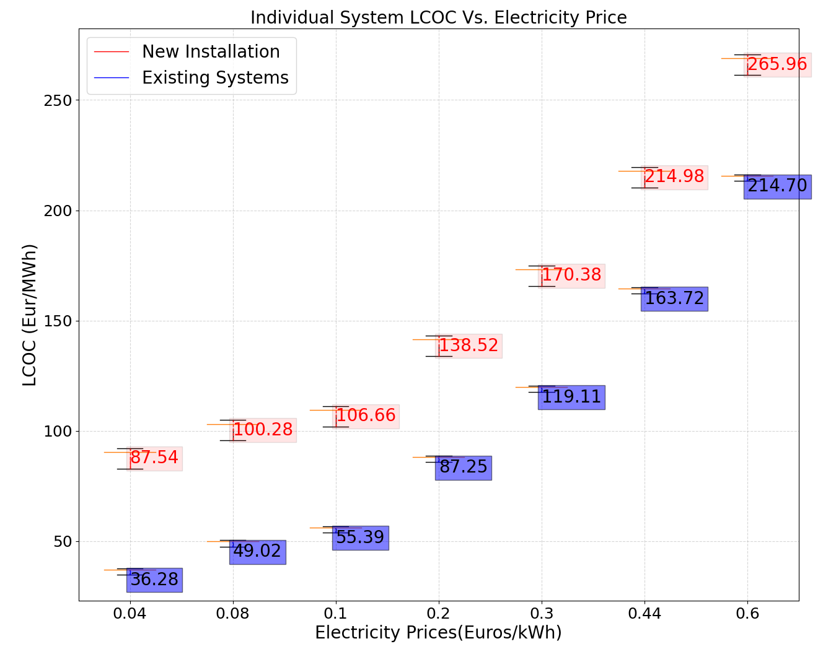
Results - Impact of Electricity Prices
Types of systems
New Systems – Initial Investment and operation costs
Existing Systems- Only operation costs
Electricity prices - a driver for district cooling potential
Realistic LCOC ranges from 170-215 Euros/MWh
Notes:
Fig 1: 2 sets of LCOC range (blue: locations where AC already exists, Red: cells with no DC supply). Thresholds for identification of an area are identified based on a given electricity price.
Fig 2: Operation hours ranging from 1 month to 3 months per year of cooling. This influences the impact on the peak load. The calculated values are technology-specific with the assumptions of DC.
The CDD approach does not take into consideration the technology and demand profiles are estimated from the temperature profile.
But due to simplicity, the FLH approach is used in the model.

Slide 10
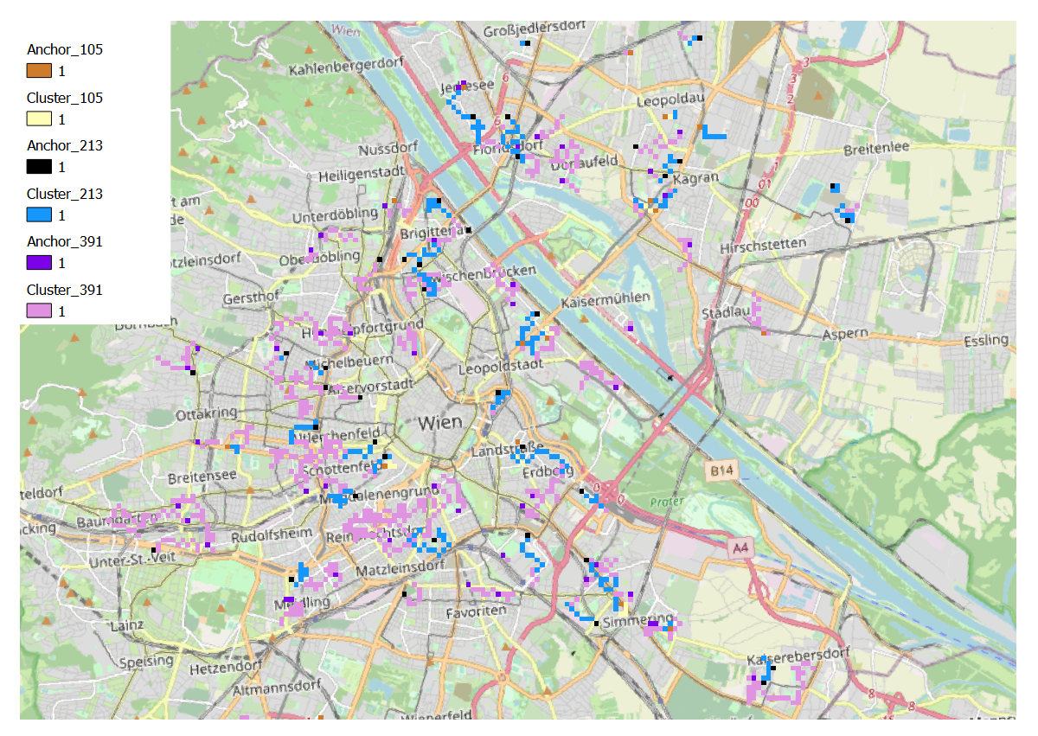
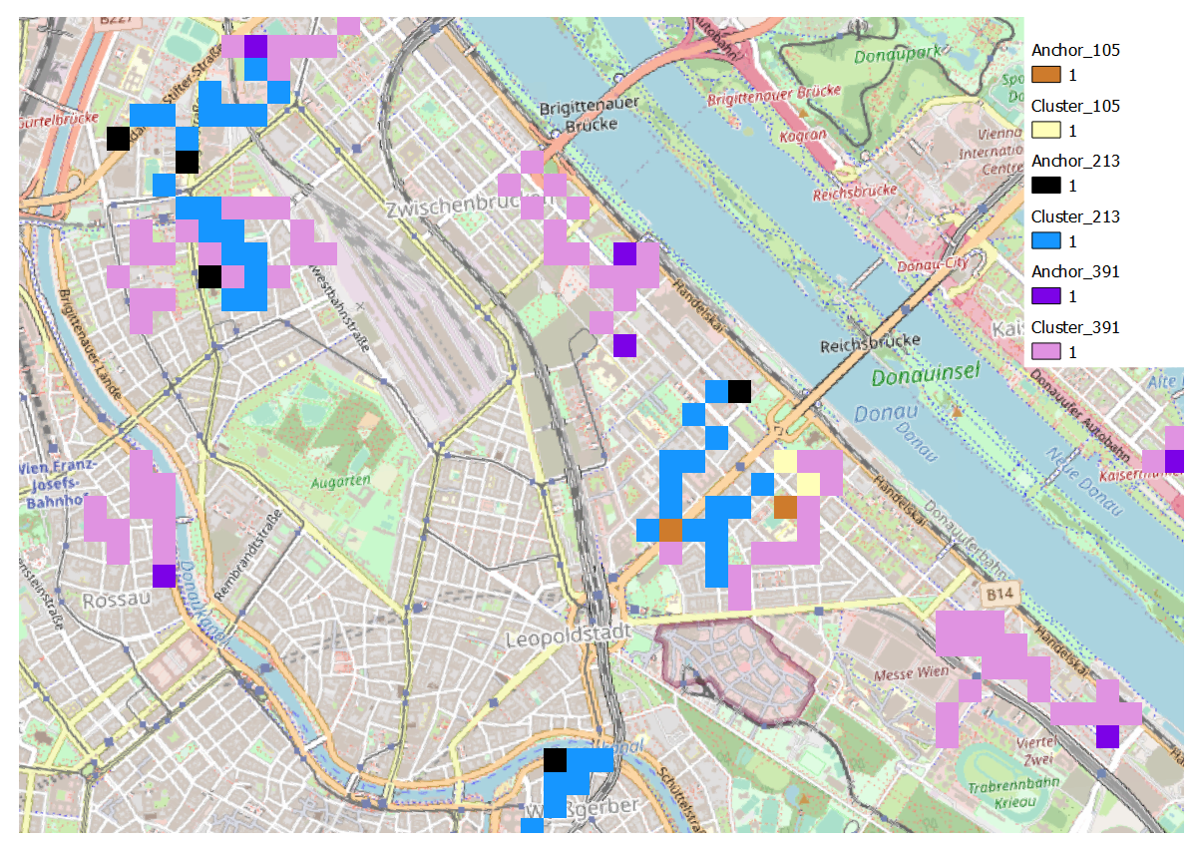
Results - Feasibility of Grid Clustering
Grid Clustering based on average overall average cost on the grid
Feasibility of the region is largely influenced by
Competitor individual technology
Pipe sizing based on peak demand
Topography

Slide 11
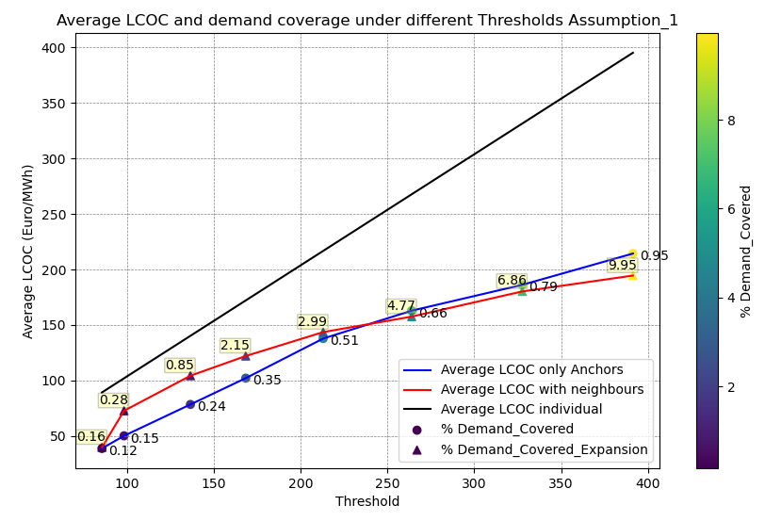
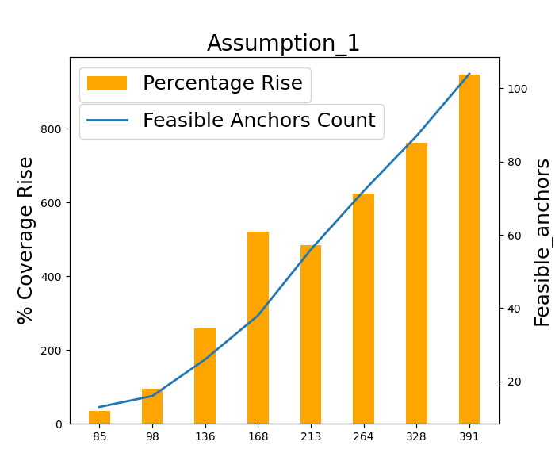
Results- Impact of Threshold on the Demand (Assumption 1)

Slide 12
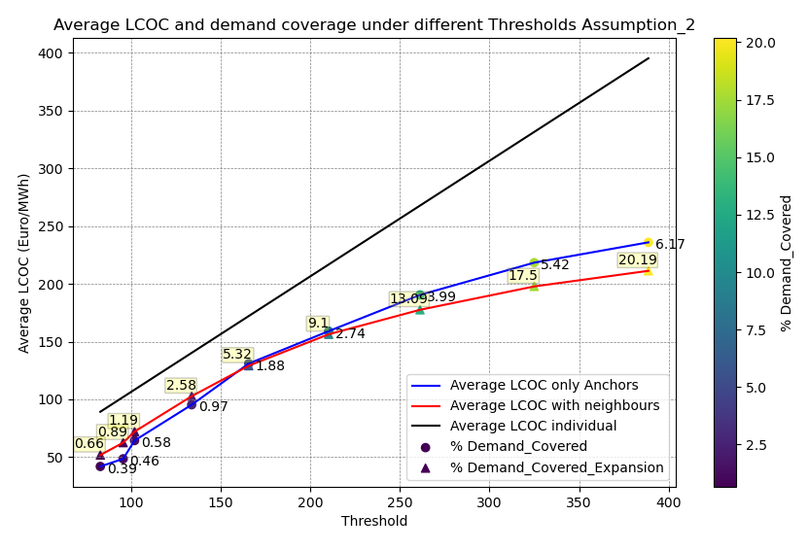
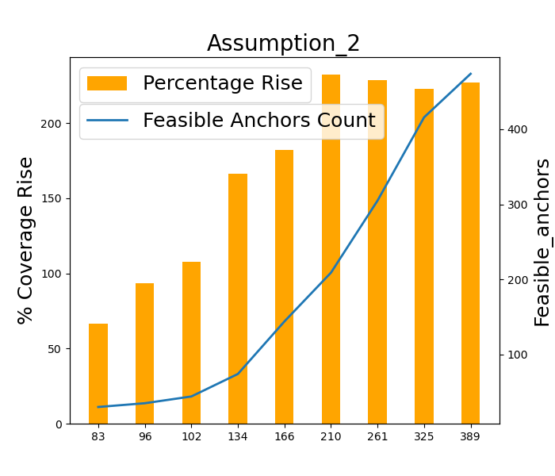
Results- Impact of Threshold on the Demand (Assumption 2)

Slide 13
Conclusion
The identified potential district cooling networks are expected to provide a range from 0.12-20% of the current demand under realistic electricity prices
The correct definition of the anchors is key to correctly estimating the potential of the district cooling network. Which assumption (1, 2 ) best models the behavior of an ideal Anchor?
The estimation of demand is largely dependent on the assumed FLH which is defined by the region and the user behavior ( for Space Cooling)
Electricity price fluctuates the operation cost of the individual System which influences the threshold for the district cooling potential identification.

Slide 14
Outlook
Identification of actual cells where the demand is supplied over the current stochastic approach
Validation of the most realistic anchor identification assumption
Validation of the model results compared to the existing grid
Identify other sensitivity parameters
Inclusion of free cooling supply sources into the model
Up-scaling to EU-27 level
The final results will be integrated into the Hotmaps toolbox within the scope of OpenGIS4ET project

Slide 15
Literature
[1] Li et.al.,‘A life cycle analysis techno-economic assessment framework for evaluating future technology pathways – The residential air-conditioning example’, https://doi.org/10.1016/j.apenergy.2021.116750
[2] Lisaba et.al., ‘Pipe sizing of district cooling distribution network including in energy transfer station’, doi:10.1088/1757-899X/1109/1/012016
[3] Volkova et.al., District Cooling Network Planning. A Case Study of Tallinn, http://doi.org/10.54337/ijsepm.7011
[4] Agusto et.al., Identification of design criteria for district cooling distribution network

Slide 16
Thank you.
Questions?
Suggestions?
E-mail: malla@eeg.tuwien.ac.at

