Slide 1






Uncertainty in Energy System Modeling
Lessons from case studies with GENeSYS-MOD
This project has received funding from the European Union’s Horizon 2020 research and innovation programme under grant agreement No. 835896

Slide 2
We deal with a lot of uncertainty in energy system modeling
We face a lot of uncertainty in the energy system: past, present, and future
Just to name a few:
  Cost developments of batteries
  Will nuclear fusion ever become viable?
  How does the geopolitical landscape in 25 years look like?
Different uncertainties require different methodologies to address them
The question remains: In how far can we trust results from (deterministic) energy system models?

Slide 3
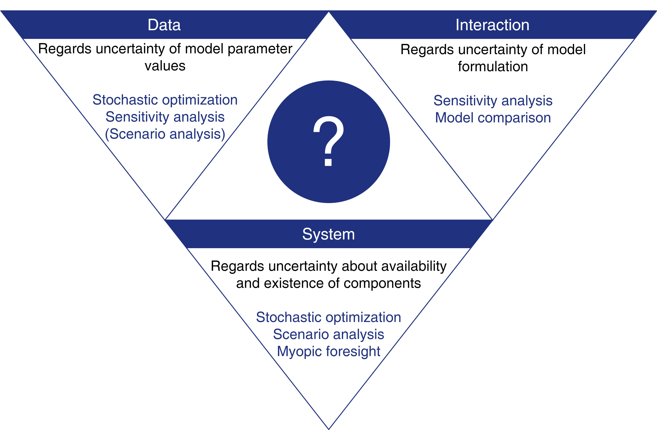
Types of uncertainty in modeling

Slide 4
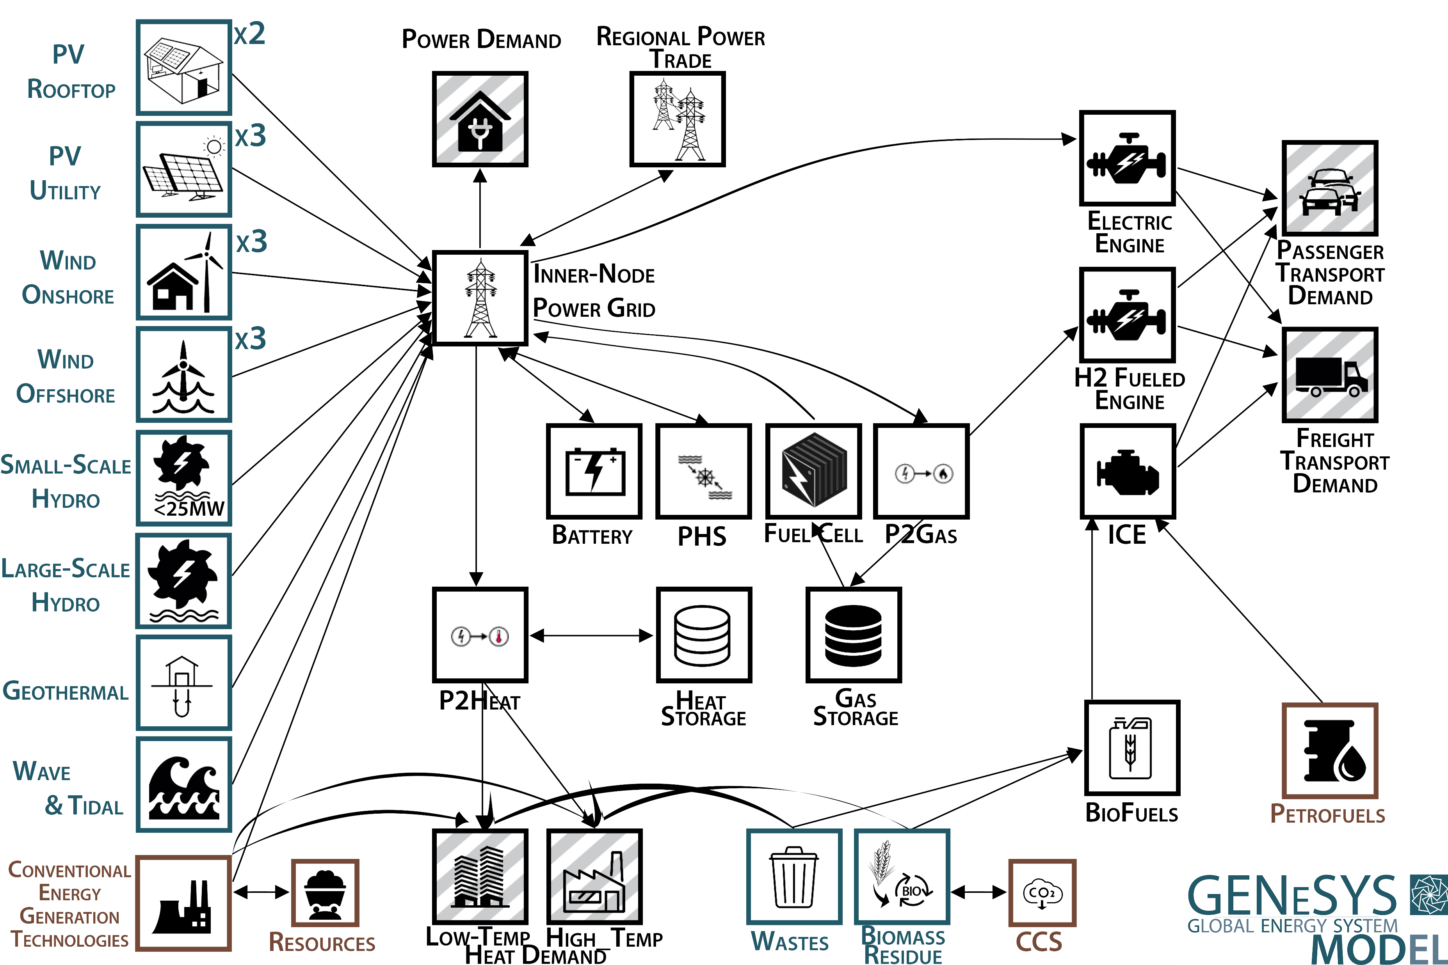
GENeSYS-MOD…
… based on OSeMOSYS and developed since 2016
…publicly available with model, data, and manual¹
Results in this presentation (mainly) based on European and German case-studies
¹ https://git.tu-berlin.de/genesysmod/genesys-mod-public

Slide 5
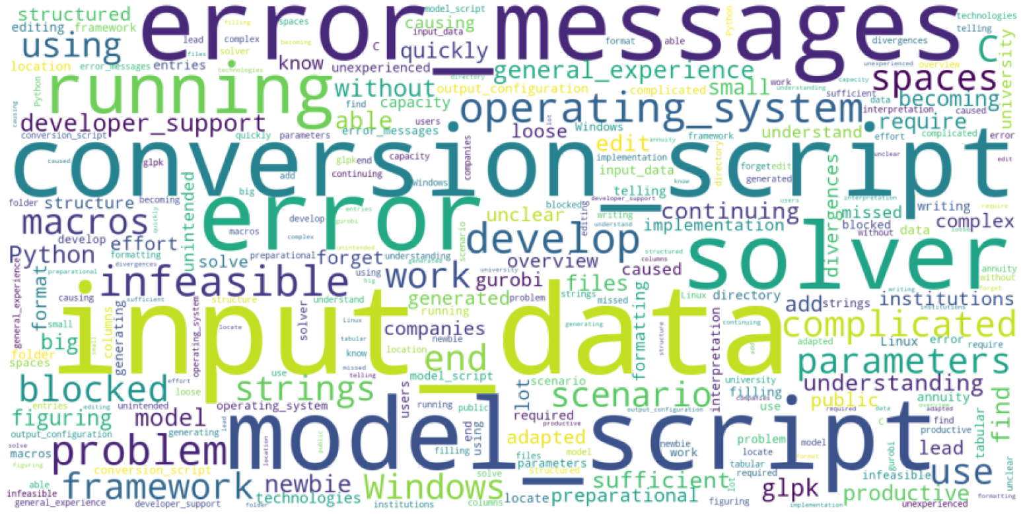
Open-science as a major cornerstone
Goes beyond open-source – data, source code, methodology, publications, etc. should all be publicly available
Work benefits from higher exposure, possibility to get validated, and others can build upon it
Most crucially: adequate result communication requires the possibility to replicate not only the results but also methodology and assumptions
However: barriers are still high when trying to use other developer‘s frameworks

Slide 6
Key takeaways and messages
Accounting for uncertainty adds layers of robustness to analysis and is crucial when communicating these results to policy and decision makers
No-regret options:
  No new fossil fuel capacities required, they rather put the decarbonization at risk
  No room for delayed action
  Electrification is key, hydrogen most likely only in a complementary role
  Focus on energy demand reduction measures in the long-term, carbon price in the medium-term

Slide 7
Temporal, regional, and sectoral disaggregation
Regional particularities and renewable potentials might differ from the results of global energy system models.
The effect of higher time resolution is less pronounced after a certain point than that of operational detail, and vice versa.
Many aspects not yet covered in energy system models play a crucial role in the energy transition.

Slide 8
Energy demand important factor in decarbonization‘s success
Reducing energy demand shows the strongest effect on many indicators like emissions, installed capacities and system costs
These effects are most pronounced in the long-term (2040-2050)
While efficiency improvements can play a role in reducing energy demand, sufficiency proves to be more effective but also more difficult to target as a policy or decision maker

Slide 9
Carbon price effective, but mostly in the medium-term

Slide 10
Additional fossil capacity expansions most likely end up being stranded
Short-sighted decision making can put the decarbonization‘s success at risk
Case-study focusing on Europe with three scenarios, simulating myopic foresight
If long-term requirements and developments are ignored, significant stranded assets as a result
Of course we face short-term problems, especially nowadays – but long-term goal should has to be considered when solving them

Slide 11
Key takeaways and messages
Thank you for your attention!
Dr. Karlo Hainsch
k.hainsch@tu-berlin.de
Accounting for uncertainty adds layers of robustness to analysis and is crucial when communicating these results to policy and decision makers
No-regret options:
  No new fossil fuel capacities required, they rather put the decarbonization at risk
  No room for delayed action
  Electrification is key, hydrogen most likely only in a complementary role
  Focus on energy demand reduction measures in the long-term, carbon price in the medium-term

