Slide 1
February 17th, 2023
Fully Integrated Renewable Energy Communities and their Implications for the Power Grid and Market Structure
Helmut BRUCKNER
Sonnenplatz Großschönau
Albana ILO
TU Wien
Marketa ADAMCOVA
LEEF Technologies
Karthik BHAT
FH Technikum Wien

Slide 2
2
Acknowledgement
This paper is written within the INTERACT project:
INTERACT as transnational research project is supported by the Austrian Ministry of Climate Action, Environment, Energy, Mobility, Innovation, and Technology (BMK), Technology Agency of the Czech Republic (TAČR) and Swedish Energy Agency / Viable Cities, Sweden.
It has received funding in the framework of the PED Programme, which is implemented by the Joint Programming Initiative Urban Europe and SET Plan Action 3.2. The project has been selected for funding in Positive Energy Districts (PEDs) pilot call JPI Urban Europe. (see also https://jpi-urbaneurope.eu/ped/ )
Project Start: February 2021
Planned Project End: January 2023
Total budget: 575.000 EUR

Slide 3
3
Definition: Fully Integrated Energy Community
The definition¹ of the ‘Fully Integrated Energy Community’ is an extension of the definition of the Renewable Energy Community from the Renewable Energy Directive (EU) 2018/2001:
'Fully Integrated Energy Community' means a legal entity:
which is based on open and voluntary participation. It is autonomous and effectively controlled by shareholders or members that are located in the proximity of the renewable energy projects, owned and developed by that legal entity;
where the shareholders or members are natural persons, SMEs or local authorities, including municipalities;
with the primary purpose to provide environmental, economic or social community benefits for its shareholders or members or for the local areas where it operates, rather than financial profits;
which establishes and operates local markets in harmony with the grids and other markets to enable the active energy trading of the shareholders or members
1) See „Design of the Energy Community Organization according to the LINK-Solution“, 31.01.2022, available online www.ped-interact.eu

Slide 4
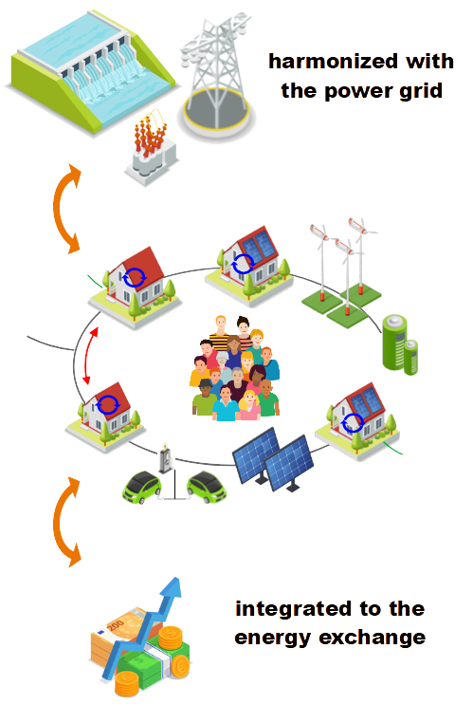
4
Vision: Fully Integrated Energy Communities
Holistic system architecture ensures a standardized structure across all network levels and customer installations, and enables their seamlessly coordinated integration and operation
Appropriate reactive power control strategy increases grid capacity, reduces data exchange
Citizen centred approach based on trust, transparency and fairness
Creation of a local market to optimize the fit of production and demand, and strengthen local value streams
Community building and knowledge exchange to strengthen social cohesion and local capabilities
New market structure proposed: national, regional and local market levels with vertical integration

Slide 5
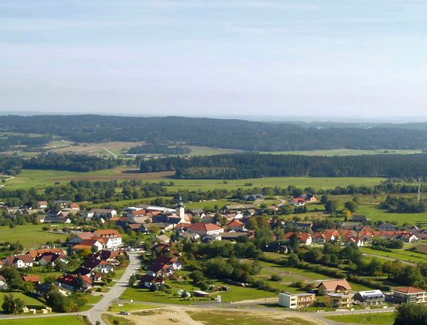
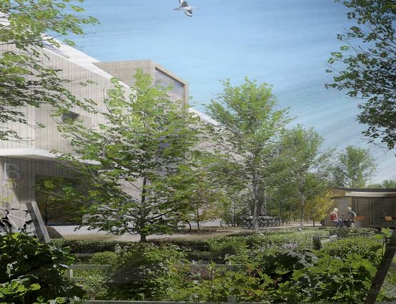
5
Creation process of the Fully Integrated Energy Community
A) Stakeholder Integration & Best Practice
B) Available and Necessary Technology
C) Organisation & Operation
Roadmap
for the implementation of fully integrated Energy Communities
D) Legal & Economics

Slide 6
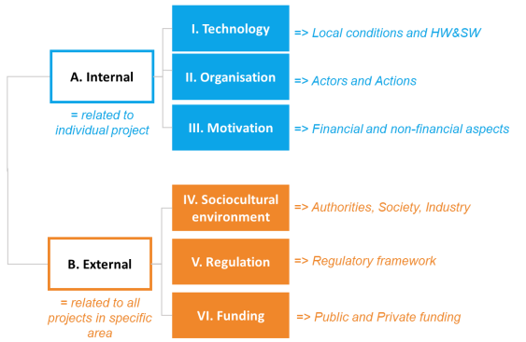
6
A) Stakeholders and Best Practice
Analysis of Showcase Projects:
58 projects in Europe (AT, BE, CZ, SE) analyzed
16 projects chosen for telephone interviews with key actors
Used and common Competences analyzed and compared
Evaluation of Needs and Motivation of Stakeholders of Energy Communities:
14 interviews in Großschönau: municipality, infrastructure, businesses, farmers, associations, citizens, opinion leaders, specialized groups (i.e. KEM, KLAR!)
3 interviews in Fyllinge: municipality, DSO, project developer
Success Factors¹ as planning help:
Results transfered into Key Success Factors and Requirements for basic and fully integrated Energy Communities
1) See „Key success factors and requirements for INTERACT energy communities“, January 2022, available online www.ped-interact.eu

Slide 7
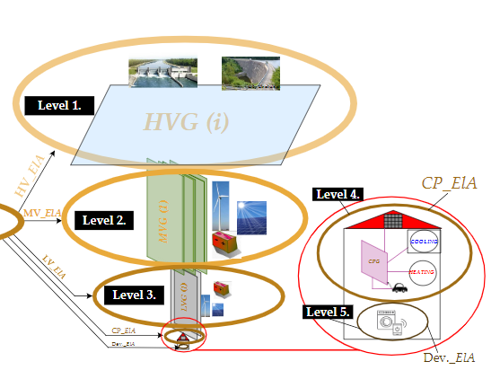
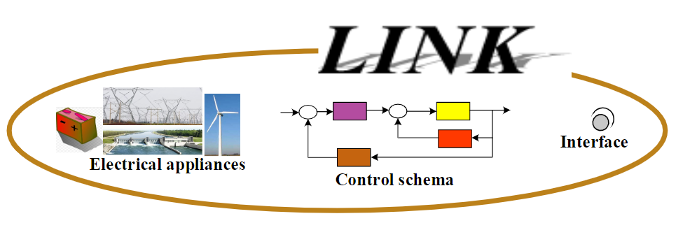
7
B) Available and Necessary Technologies I
Holistic Solution for Smart Grids based on LINK-Paradigm¹
Grids have a fractal structure. The fractal pattern of the power system is described in LINKS and applied on all defined power grid levels:
Energy Supply Chain Net is an holistic technical model for power systems that consists of a set of automated power grids, intended for chain links, which fit into one an-other to establish a flexible and reliable electrical connection. Each individual link or a link-bundle operates autonomously and have contractual arrangements with other relevant boundary links or link-bundles.
7
1) Ilo A., Schultis D.-L., 2022, „A Holistic Solution for Smart Grids based on LINK-Paradigm“, Springer, https://doi.org/10.1007/978-3-030-81530-1

Slide 8
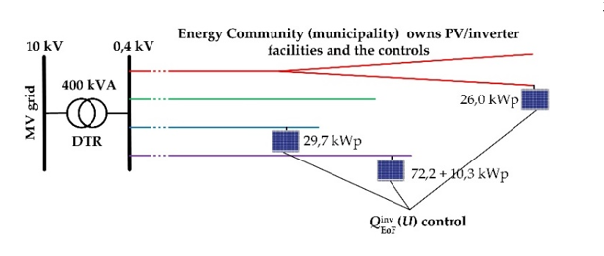
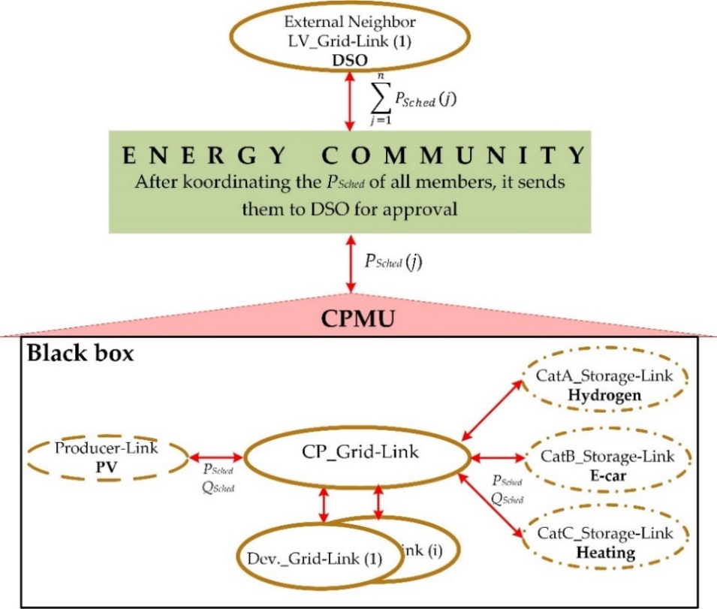
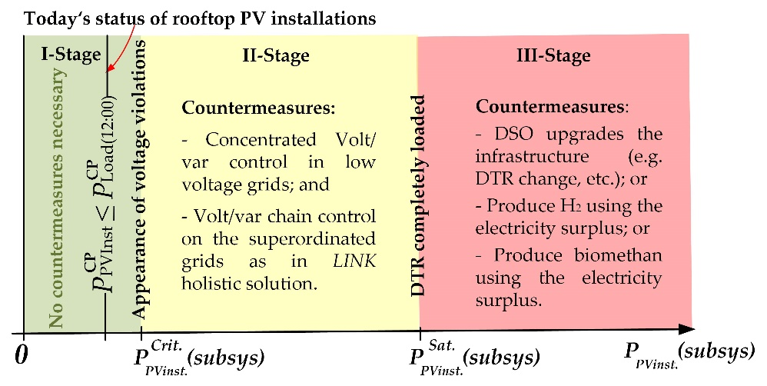
8
B) Available and Necessary Technologies II
Standardized information flow realizes data protection by design
Maximal usage of available grid capacity to promote implementation of DERs
8

Slide 9
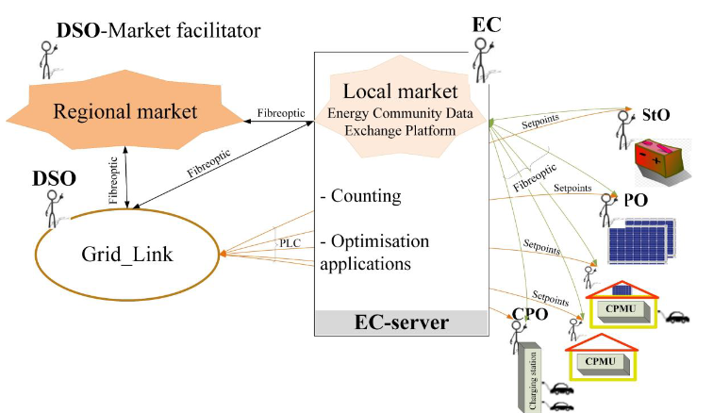
9
B) Available and Necessary Technologies III
Communication Technology Architecture¹:
Technological Link for Power Grid integration, e.g. realized with PLC
Market Link for connection to Energy Community (=Local Market), e.g. realized with fibre-to-home
Overview:
1) See „LINK-ICT structure with communication guidelines between the actors within the electricity community“, 31.08.2022, available online www.ped-interact.eu

Slide 10
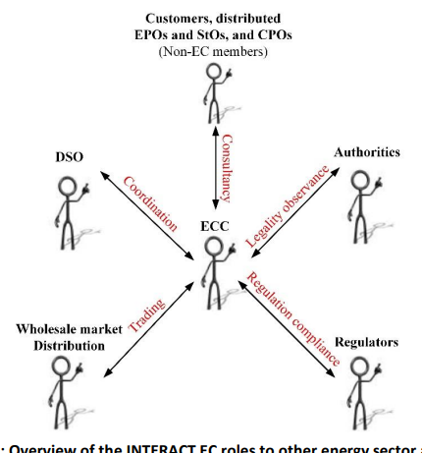
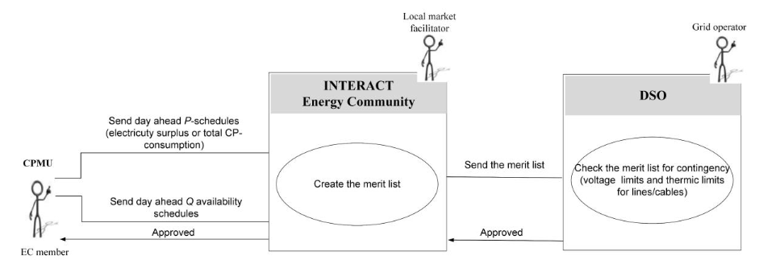
10
C) Organisation & Operation I
Organizational Structure¹:
Internal and external roles and relations, legal entity formats
Value creation and activites
Technological Use Cases²:
Normal operations, flexibilities, and emergency recovery
Long-term planning
Example: Day ahead schedules
See „Design of the Energy Community Organisation according to the LINK-Solution”, 31.01.2022, www.ped-interact.eu
See „Use Cases for the integration of the existing innovative technologies with the LINK-solution“, 15.07.2022, available online www.ped-interact.eu

Slide 11
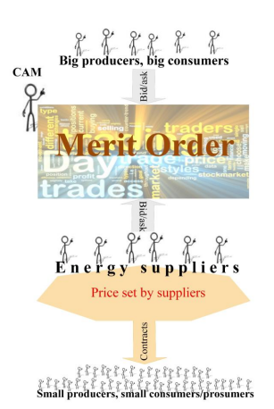
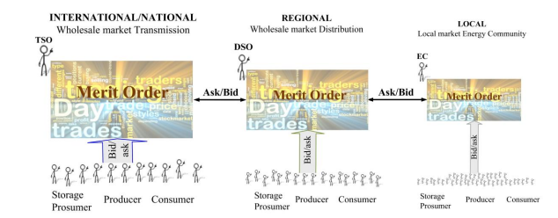
11
C) Organisation & Operation II
Current market mechanism do not allow Energy Communities to participate directly in the market¹. We suggest to adapt them:
Current market
mechanism:
Proposed new
market mechanism:
11
1) See „Market structure and its interfaces with the Energy Community“, 21.11.2022, online www.ped-interact.eu

Slide 12
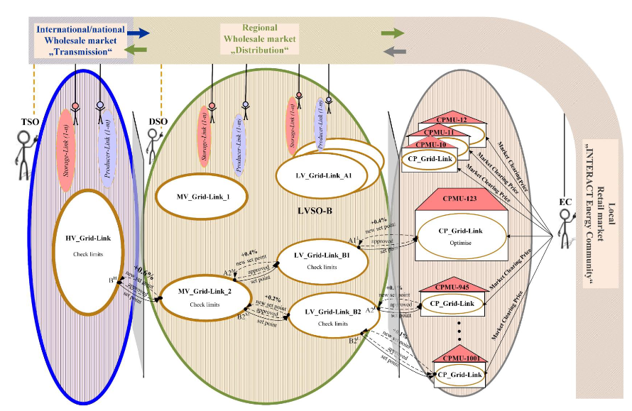
12
C) Organisation & Operation III
Proposed new market structure and selected pricing models¹:
New structure proposed in-line with the structure of the power grid
Selected pricing models discussed as alternativ to current merit-order model
Proposed new
market structure:
12
1) See „Market structure and its interfaces with the Energy Community“, 21.11.2022, online www.ped-interact.eu

Slide 13
13
D) Legal & Economics
Current legal situation regarding ECs and Electricity Market
Business Models for Energy Communities
From basic operation towards full integration¹
Economic Evaluation of Business Models and Contracting Models
1) See „Business cases for INTERACT Energy Communities“, 19.9.2022, online www.ped-interact.eu

Slide 14
14
Vision: Fully Integrated Energy Communities
Holistic system architecture ensures a standardized structure across all network levels and customer installations, and enables their seamlessly coordinated integration and operation
Appropriate reactive power control strategy increases grid capacity, reduces data exchange
Citizen centred approach based on trust, transparency and fairness
Creation of a local market to optimize the fit of production and demand, and strengthen local value streams
Community building and knowledge exchange to strengthen social cohesion and local capabilities
New market structure proposed: national, regional and local market levels with vertical integration

Slide 15
15
Vision: Fully Integrated Energy Community
10 Key Implementation Steps to get there¹:
Technology: Harmonize customer plants and power system
Regulation: Fractal Market solution: national, regional and local market
Regulation: Alignment of legislation on the organization of RECs
Regulation: Detail Standards and rules for new market structures
Regulation: Legislation and Grid Codes
Technology: Establish norms for technology providers
Policy: Supporting pilots of fully integrated energy communities
Stakeholder Integration: enable and facilitate participation
Policy: Large scale roll-out of fully integrated energy communities
Policy: Continuous Improvement
Preparation
National Strategy
Fast Promotion
15
1) See „Roadmap for the implementation of the designed INTERACT energy community in general and for the specific local perspectives“, January 2023, online www.ped-interact.eu

Slide 16
➔ www.ped-interact.eu ⬅
February 17th, 2023
THANK YOU !!
Fully Integrated Renewable Energy Communities and their Implications for the Power Grid and Market Structure
Helmut BRUCKNER
Sonnenplatz Großschönau
Albana ILO
TU Wien
Marketa ADAMCOVA
LEEF Technologies
Karthik BHAT
FH Technikum Wien

