Slide 1
Underlying determinants of energy-efficient retrofit (EER) decisions
Presenter: Ardak Akhatova
Co-authors: Derkenbaeva, E., Kranzl, L., van Leeuwen, E., Halleck Vega, S., Hofstede, G.J.
IEWT2023, Gebäude & Wärme II
Freitag, 17. Februar, 2023

Slide 2
Outline
Motivation and Aim
Method and Data
Results and Discussion
Conclusions and Policy Implications
Contribution to previous research
Limitations and Future work

Slide 3
Introduction
Motivation
  Accelerating the rate of energy-efficient retrofitting (EER) requires policy support
  Important to determine factors associated with homeowners’ decisions to retrofit (e.g. age, home size, etc)
  There is a considerable body of literature focusing on such factors
Gap
  The relationships between the studied factors remain unclear and contradictory
  Having a lot of variables (i.e. high dimensionality) complicates the interpretation and, thus, it is difficult to use the findings further, e.g. in agent-based models.
Aim
  To determine the relationship between the factors commonly associated with energy-efficient retrofitting (EER) decisions of homeowners
Notes:
Low rate of retrofit → we need policy support (like for example MEPs)
However, for policies to be effective we need to learn about the owners of buildings.
One big group is homeowners (owner-occupiers)

Slide 4
Methods
Data and variables
Systematic literature review
Data preparation
Principal Component Analysis
Logistic regression
Variable 1
Component 1
Double glazing
Variable 2
Insulation
Component 2
PV adoption
Variable n
Component n
HP adoption
Dutch household survey WoON (2021) about living conditions (N=25,659)
25 continuous and categorical (ordinal, nominal, binary) variables
Socio-demographic variables | Dwelling-related variables | Other variables
Length of residence Income of a household Wealth Age of a homeowner Education Household size Urbanity of a neighbourhood Insecurity of a neighbourhood (evaluated by respondents) | Building age Usable area Electricity consumption (annual) Gas consumption (annual) Dwelling type (apartment, terraced, etc.) Property value (evaluated by the municipality) | Want to move Home satisfaction Environment satisfaction Contact with neighbours Engagement in the neighbourhood Past outdoor maintenance Past indoor maintenance Existing insulation Existing window insulation Existing PV Existing heat pumps
Notes:
Methods
Systematic lit. review (which factors are associated with EER and PV Adoption?)
Principal component analysis (what are the new, reduced “factors”?)
Binary logistic regression (which of the new “factors” are good predictors of EER and PV adoption?)

Slide 5
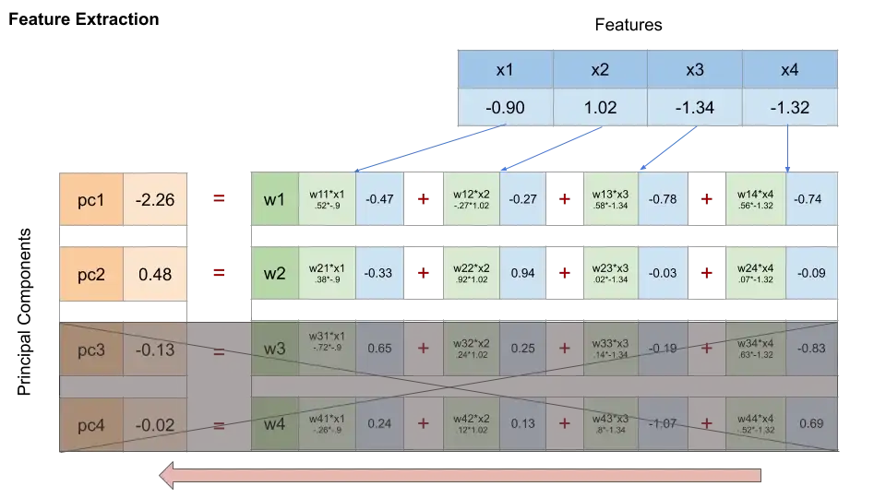
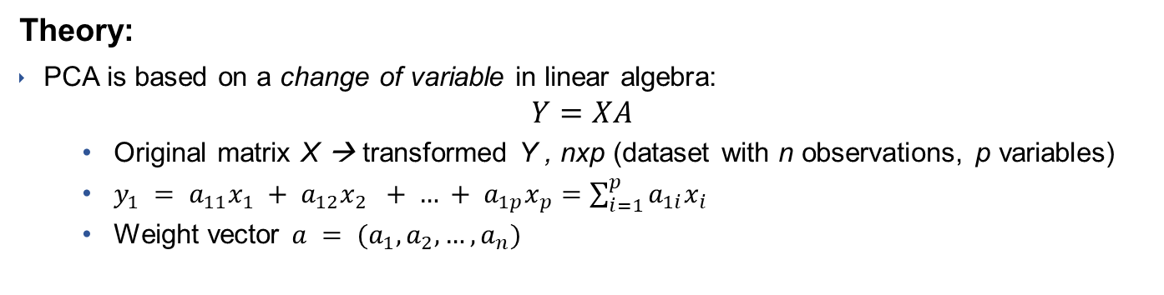
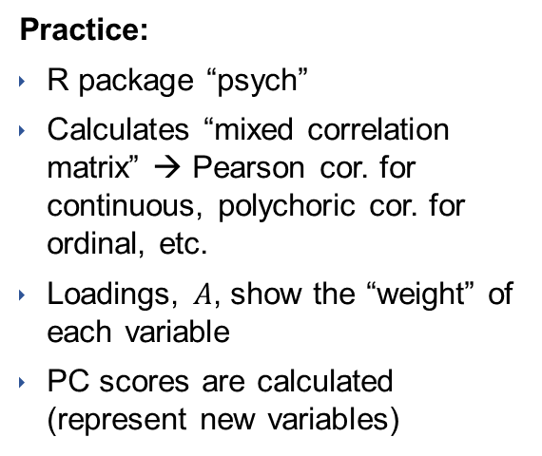
Methods
Principal component analysis
Theory:
PCA is based on a change of variable in linear algebra:
$$Y=XA$$
  Original matrix X → transformed Y , nxp (dataset with n observations, p variables)
  $y_{1} = a_{11}x_{1} + a_{12}x_{2} + … + a_{1p}x_{p}=\sum_{i=1}^{p}{a_{1i}x_{i}}$
  Weight vector $a = (a_{1}, a_{2},…, a_{n})$
Variables (Features)
Practice:
R package “psych”
Calculates “mixed correlation matrix” → Pearson cor. for continuous, polychoric cor. for ordinal, etc.
Loadings, $A$, show the “weight” of each variable
PC scores are calculated (represent new variables)
Source: https://towardsdatascience.com
Notes:
the transpose of the matrix of eigenvectors (selected top k rows) = component loading matrix A
- I think it would also be interesting to show how the PCA method derives the matrix A (at least I did not fully understand that from your presentation)

Slide 6
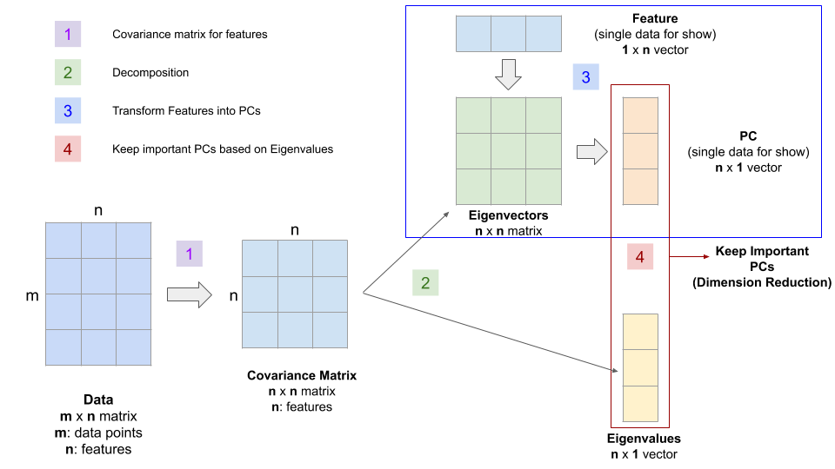
Methods
Matrix A derivation

Slide 7
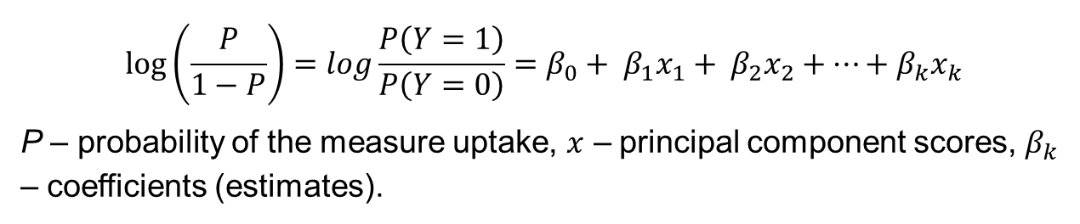
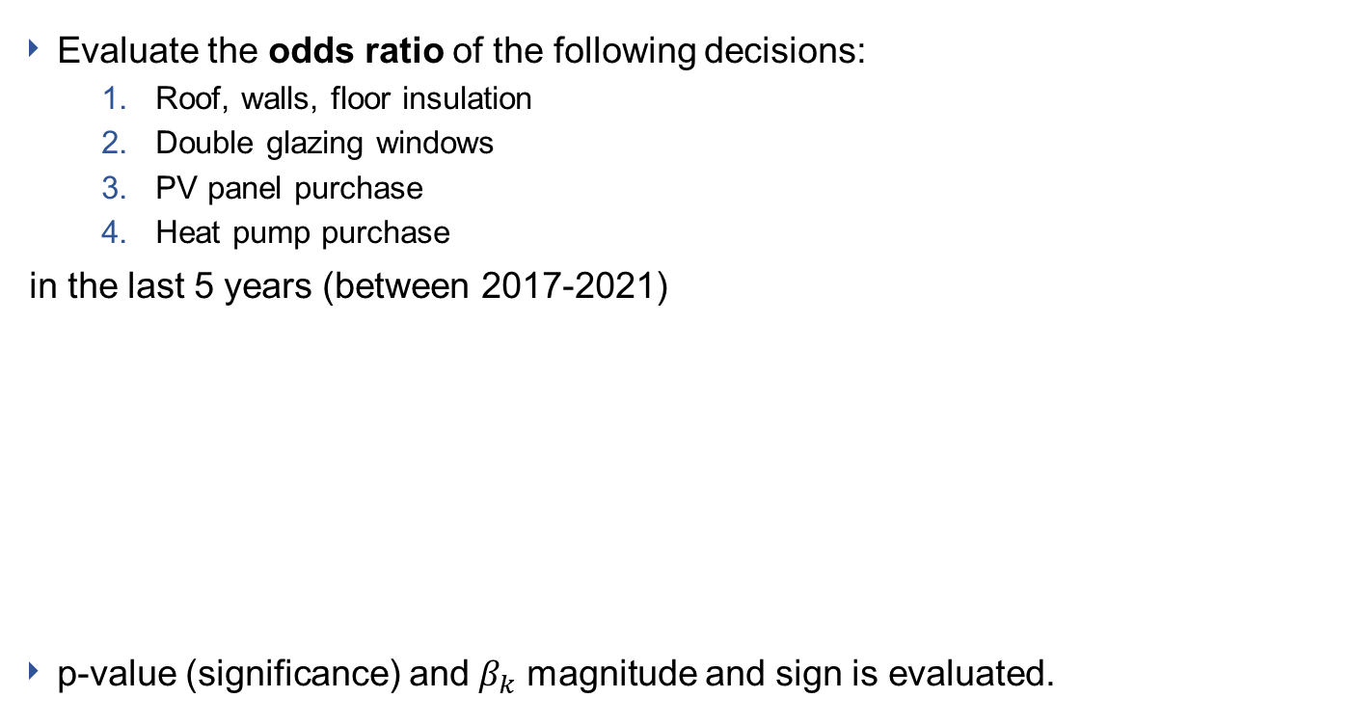
Methods
Binary logistic regression
Evaluate the odds ratio of the following decisions:
  Roof, walls, floor insulation
  Double glazing windows
  PV panel purchase
  Heat pump purchase
in the last 5 years (between 2017-2021)
p-value (significance) and $β_{k}$ magnitude and sign is evaluated.
$$log\left(\frac{P}{1−P}\right)=log\frac{P\left(Y=1\right)}{P\left(Y=0\right)}=β_{0}+ β_{1}x_{1}+ β_{2}x_{2}+…+β_{k}x_{k}$$
P – probability of the measure uptake, $x$ – principal component scores, $β_{k}$ – coefficients (estimates).

Slide 8
Results & Discussion
Descriptive statistics: Adoptions

Slide 9
Results & Discussion
Principal component analysis
Variables | Components
 | 1 | 2 | 3 | 4 | 5 | 6 | 7 | 8
Length of residence |  |  | 0.81
Building age |  |  |  | -0.72
Income |  | 0.68
House value |  | 0.80
Wealth |  | 0.75
Usable area | 0.47 | 0.48
Electricity consumption | 0.54 | 0.39
Gas consumption | 0.58 | 0.37
Age |  |  | 0.85
Education |  |  | -0.42 |  |  |  |  | 0.47
Household size | 0.48 |  | -0.60
Contact with neighboors |  |  |  |  |  |  | 0.85
Want to move |  |  |  |  | -0.80
Urbanization level | -0.74
Home satisfaction |  |  |  |  | 0.80
Environment satisfaction |  |  |  |  | 0.60 |  | 0.41
Neighborhood engagement |  |  |  |  |  |  | 0.83
Neighborhood insecurity |  |  |  |  |  |  |  | -0.74
Dwelling type | -0.88
Past maintenance (outdoor) |  |  |  |  |  | 0.74
Past maintenance (indoor) |  |  | -0.38 |  |  | 0.64
Existing insulation |  |  |  | 0.74
Existing double glazing |  |  |  | 0.60
Existing PV |  |  |  |  |  | -0.50 |  | 0.35
Existing heat pumps |  |  |  | 0.45 |  | -0.63
cut-off value = 0.35
Cumulative Var. = 0.65

Slide 10
Results & Discussion
Principal component analysis
1.Single-family houses in rural areas
2. Wealthier households
3. Older, smaller households in long-owned homes
4. Newer houses with EER already in place
5. Households satisfied with their homes
6. Homes with past maintenance
7. Households actively participating in neighborhood cohesion
8. Safer neighborhoods with highly educated inhabitants
+ home area, household size, el. & gas cons.
+ income, wealth, house value, home area, el & gas cons.
+ age, length of residence
- building age, gas cons.
+ Home and environment satisfaction
+ Contact with neighbours, neighbourhood engagement, environment satisfaction
+ Education, existing PV
- dwelling type, urbanization level
- household size, education
+ existing insulation, double glazing, & heat pumps
+ Past indoor and outdoor maintenance
- existing PV and heat pump
- Neighbourhood insecurity
- Want to move

Slide 11
Results & Discussion
Binary logistic regression
 | Windows | Insulation | PV | Heat pumps
1. Single-family houses in rural areas | 0.123*** | 0.372*** | 0.514*** | 0.439***
 | (-0.022) | (-0.027) | (-0.023) | (-0.075)
2. Wealthier households | -0.432*** | -0.448*** | 0.060*** | 0.313***
 | (-0.023) | (-0.026) | (-0.016) | (-0.034)
3. Older, smaller households in long-owned homes | 0.078*** | 0.019 | -0.022 | -0.317***
 | (-0.021) | (-0.023) | (-0.017) | (-0.061)
4. Newer houses with EER already in place | -1.732*** | -2.430*** | 0.055*** | -0.114**
 | (-0.03) | (-0.038) | (-0.02) | (-0.057)
5. Households satisfied with their homes | -0.043* | -0.117*** | 0.271*** | 0.726***
 | (-0.022) | (-0.025) | (-0.02) | (-0.085)
6. Homes with past maintenance | 1.725*** | 1.826*** | 0.428*** | 0.306***
 | (-0.04) | (-0.045) | (-0.022) | (-0.063)
7. Households actively participating in neighborhood cohesion | 0.003 | 0.067*** | 0.053*** | 0.06
 | (-0.019) | (-0.022) | (-0.017) | (-0.057)
8. Safer neighborhoods with highly educated inhabitants | -0.038* | 0.095*** | 0.166*** | 0.197***
 | (-0.02) | (-0.024) | (-0.018) | (-0.063)
Constant | -2.276*** | -2.878*** | -1.615*** | -4.741***
 | (-0.027) | (-0.036) | (-0.018) | (-0.077)
McFadden-R² | 0.242 | 0.366 | 0.053 | 0.072
Notes: *p<0.1; **p<0.05; ***p<0.01; N=25,659

Slide 12
Results & Discussion
Likelihood to retrofit by population group
More likely to retrofit are homeowners who...
Less likely to retrofit are homeowners who...
Live in newer buildings with insulation and double-glazing (only PV!)
Live in single-family houses in rural areas
Previously maintained their homes
Live in safer neighbourhoods and have higher education (except windows)
Actively participate in neighbourhood life (insulation and PV)
Are older, live with few people and have owned their residences for long time (for heat pump)

Slide 13
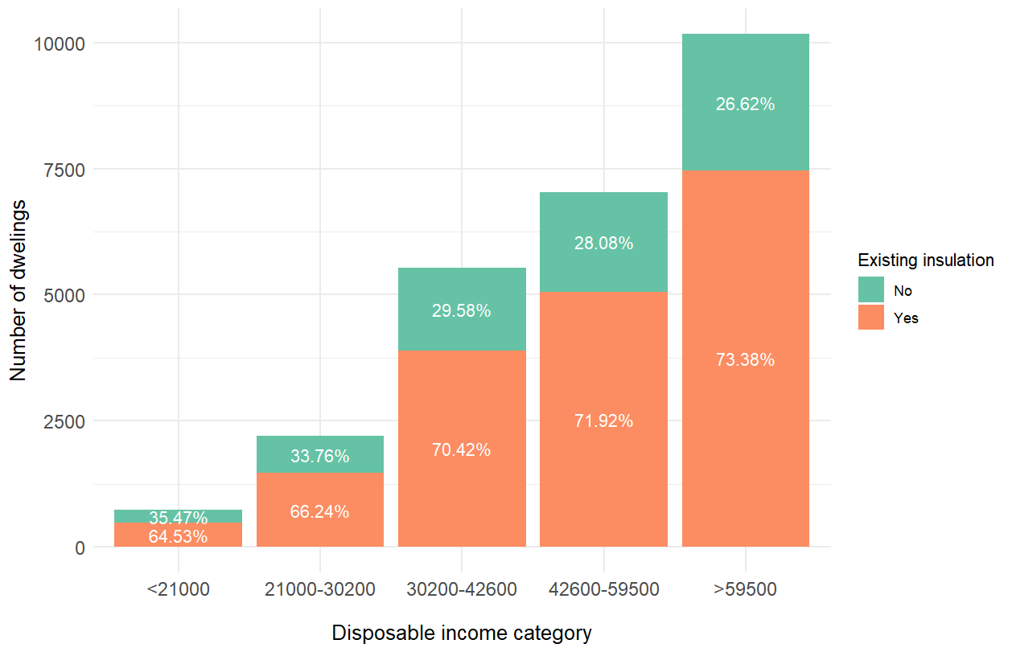
Results & Discussion
Wealthier homeowners prefer heat pumps and PV
Wealthier households are more likely to implement heat pumps and solar panels (and less so window and envelope insulation).
Notes:
The interquartile range is the central 50% or the area between the 75th and the 25th percentile of a distribution. A point is an outlier if it is above the 75th or below the 25th percentile by a factor of 1.5 times the IQR.

Slide 14
Results & Discussion
Reasons to adopt

Slide 15
Results & Discussion
Reasons not to adopt

Slide 16
Conclusions and Policy Implications
Policies that have been in force have reached wealthier single-family house owners, however, the case of apartment owners in multi-family houses should be taken more seriously.
  Need to look at regulatory and administrative barriers and housing policy
Satisfaction with the neighborhood, engagement in the neighborhood, and living in safer neighborhoods are correlated positively with insulation and PV adoption
  Investing in the cohesion and livability of the neighborhoods could bring more EER uptake
Population groups that are least likely to renovate are
  Older people living in 1- or 2-people households
  New houses (es. built after 2008), as they have well-insulated houses → only PV

Slide 17
Contribution to previous research
Halleck Vega et al (2022) and Ebrahimigharebaghi et al(2019)
  binary logistic regression to determine factors associated with retrofit in the Netherland
Shows the relationship between variables
Newest dataset and heat pump adoption
Perspective on neighbourhood-relevant factors
Identified groups in the population who are more likely to retrofit and who are not
More focused/refined outcomes

Slide 18
Limitations and Future Work
The variables are not an exhaustive list
  awareness (e.g., about energy efficiency, available subsidies, environmental consequences) should be included in further research
Correlation does not mean causality
More qualitative research unveiling the barriers of specific groups of homeowners, such as the elderly or homeowners with past maintenance
  understand how to support or encourage these groups.
Conducting panel surveys instead of cross-sectional studies
  it would allow examining the effect of new measures or a change of attitude toward EER over time
Our further research will be focused on implementing these findings in Agent-based model or retrofitting uptake on a local level

Slide 19
Thank you for your attention!
Ardak Akhatova
akhatova@eeg.tuwien.ac.at

Slide 20
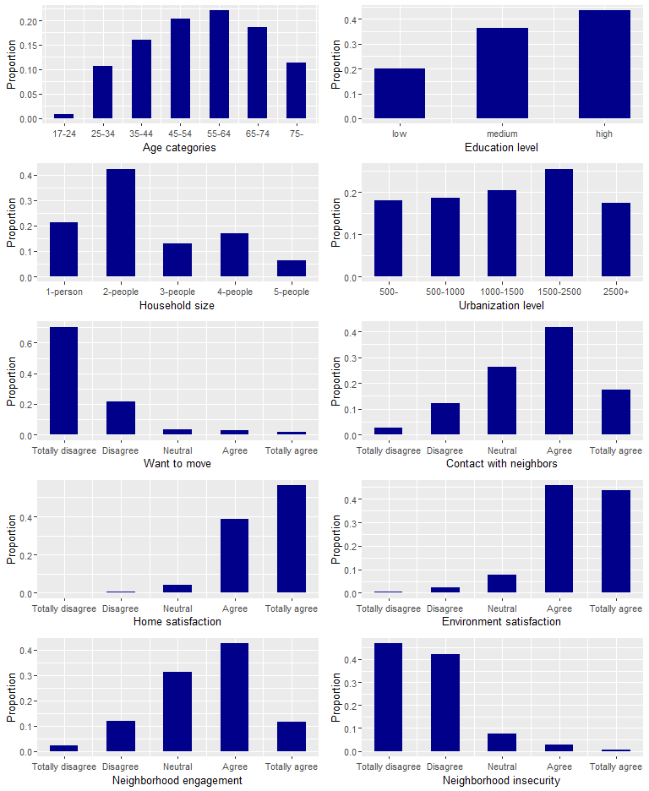
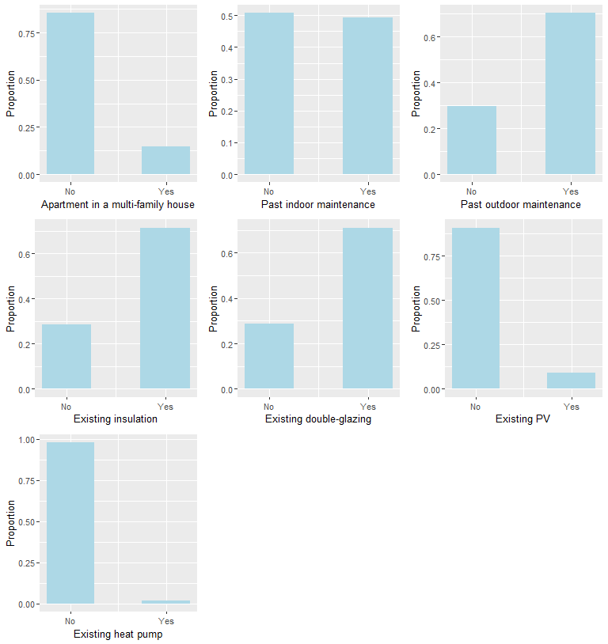
Descriptive results

