Slide 1






How to explore a large scenario space of future power systems?
A multi-perspective analysis for Germany
IEWT, 15th of February 2023, VIenna
Ulrich Frey¹, Karl-Kiên Cao¹, Thomas Breuer², Manuel Wetzel¹, Shima Sasanpour¹, Jan Buschmann¹, Kai von Krbek¹ and Aileen Böhme³
2
3
1

Slide 2
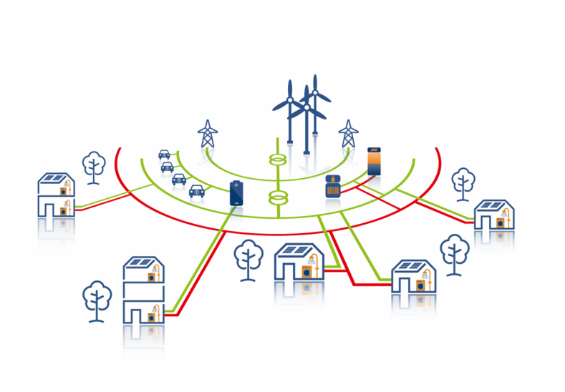
Exploring the Scenario Space
The state of the art
Best case
Trend
Worst case
Decarbonized futures

Slide 3
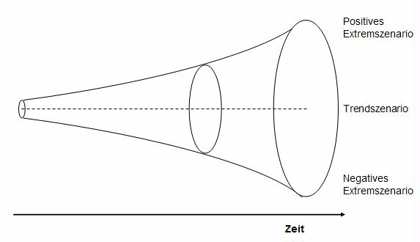
Exploring the Scenario Space
The objective
Point of interest
Scenarios: n = 3600
Decarbonized futures

Slide 4

MEthodology

Slide 5



Three Main Challenges
Which scenario assumptions?
Huge solving
times
Which evaluation perspective?

Slide 6


Three Solutions
Scenario Assumptions
Solving times
Evaluation Perspective
Scenario Generator
Parallelization on Supercomputers
Model coupling

Slide 7
Introducing a complex workflow
Scenario Generator
Indicator Models
Raw Data
POIs
Preprocessing
Sampling
AMIRIS
Python Scripts
Instance Generator
LP Solver
Postsolve
REMix (.dmp)
PIPS-IPM++
Scenario Result

Slide 8
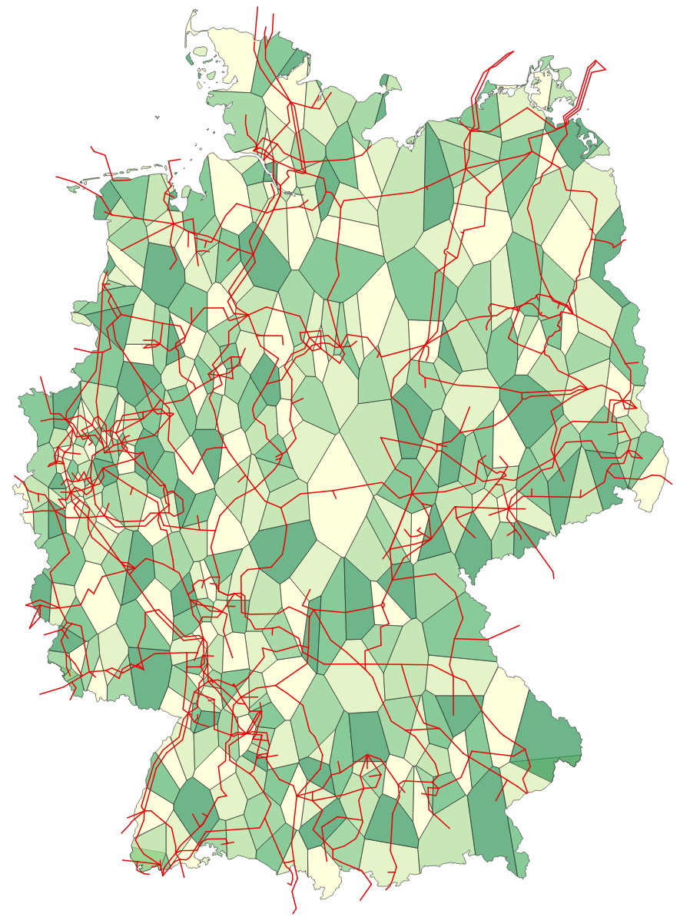

Generation of multiple model instances
Model inputs
Model instance
Model instance
Static
e.g. network topology
Model instance
Model instances
Automated sampling within provided bandwiths
„Drivers“
e.g. costs, demand
 | P₁ | P₂ | P_{n}
P₁ |  | -2 | 0
P₂ | -2 |  | 1
P_{n} | 0 | 1
min
mean
max
Literature
review
Truncated normal
distribution
Pseudo-
correlations
Notes:
Cross impact balance analysis

Slide 9
Assessment: 27 Scenario indicators¹
¹ Buschmann, J., von Krbek, K., Schimeczek, C. “Energy System Indicators”, doi: 10.23728/b2share.fe70b138419243c0817425a0d2d5ae32, 2022
Sustainability
Shannon-Wiener-Index
Exemplary Indicators | Direc-tion
RE-share | ↑
CO₂-emissions | ↓
Geographical dispersion of VRE power generation | ?
Dispersion of VRE generation
Carbon dioxide emissions
Renewable Energy Penetration Index
Security of supply
Energy self sufficiency rate
Economic feasibility
Electricity price volatilities
Energy Not Served
Average electricity price
Grid-related curtailment
Expected Flexibility Shortfall
Profitability by technology
Policy instrument costs

Slide 10
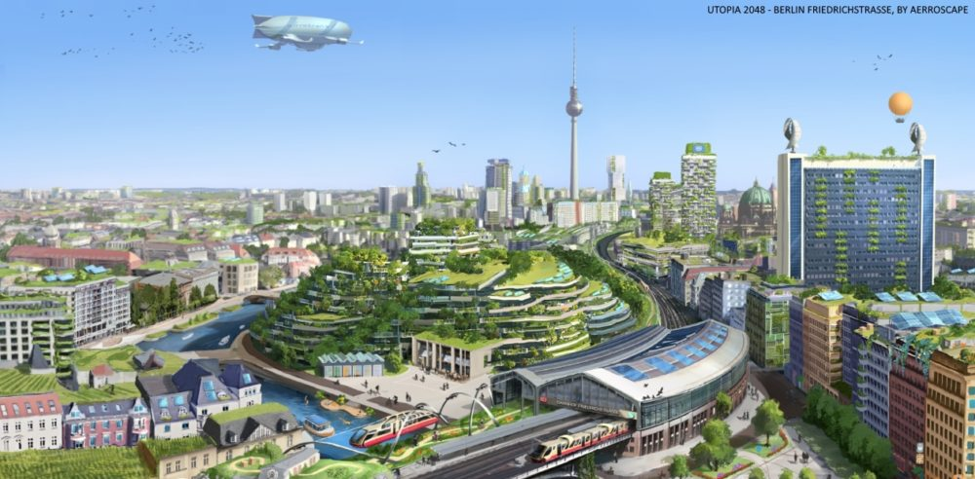
From indicators to Points-of-Interest
Good indicators = ±1 standard deviation to means of population
Scenarios with ≥ 15 “good” indicators => Points-of-Interest

Slide 11
Results

Slide 12
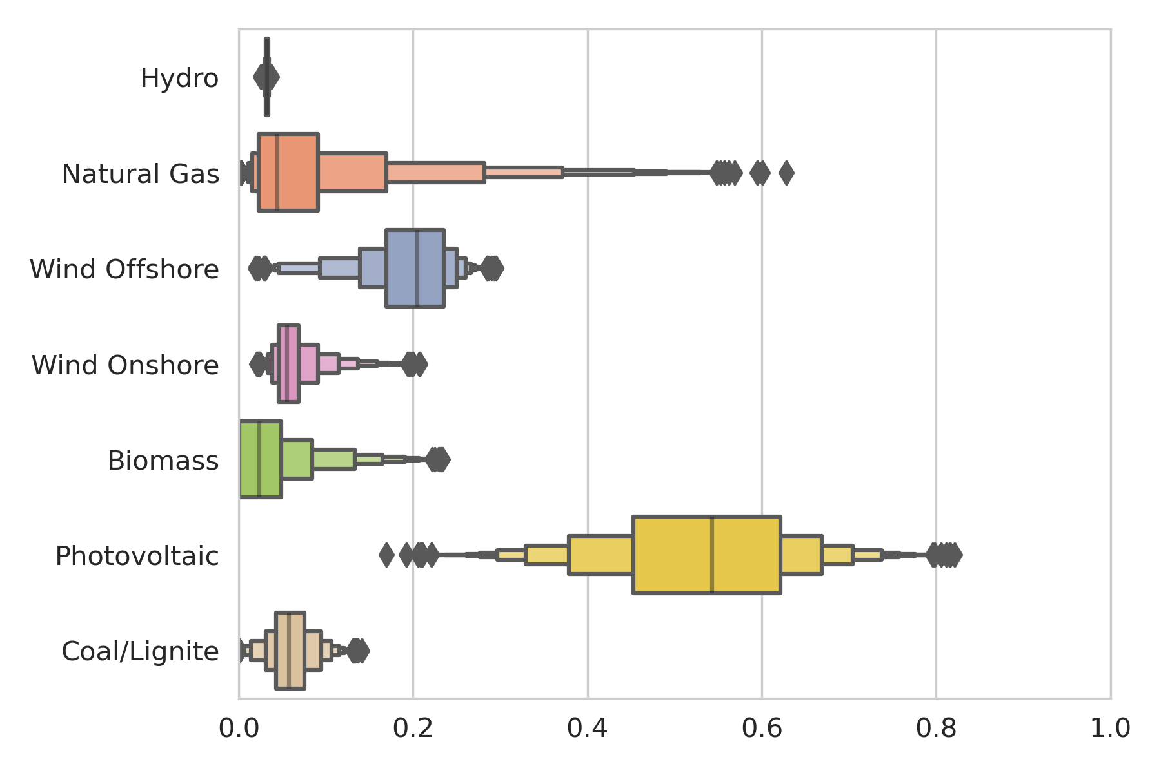
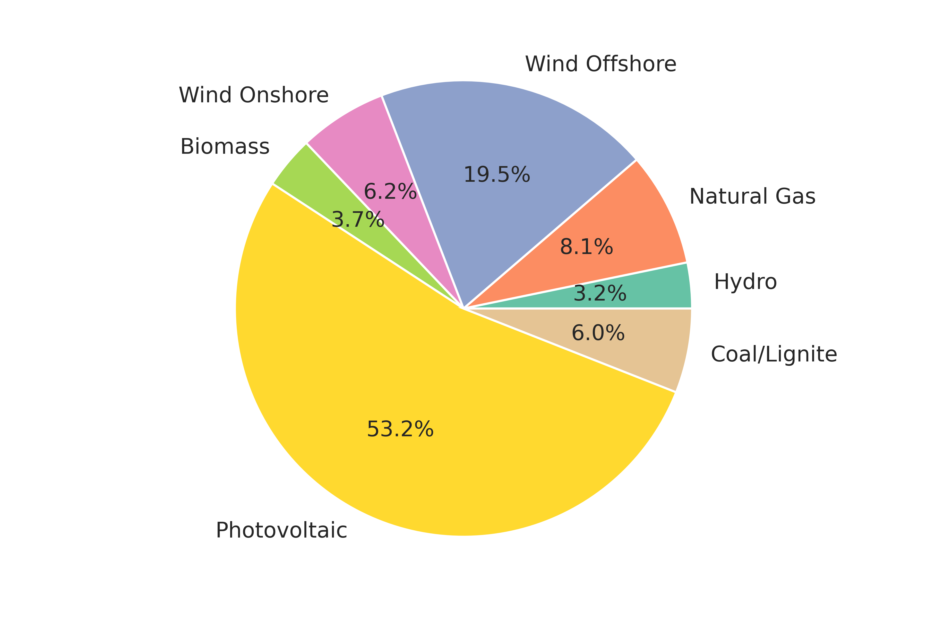
Results 1:
Overall distribution of technologies over 3600 runs

Slide 13
Results 2: Clustering scenario groups
Target: Identifying clusters of scenarios by indicators
2 methods:
  K-means (minimizes average Euclidian distance)
  K-medoids (minimizes pairwise dissimilarities)
Variation: Different number of indicators / inputs used to see if cluster numbers differ
Result: Yes, 2-5 clusters

Slide 14
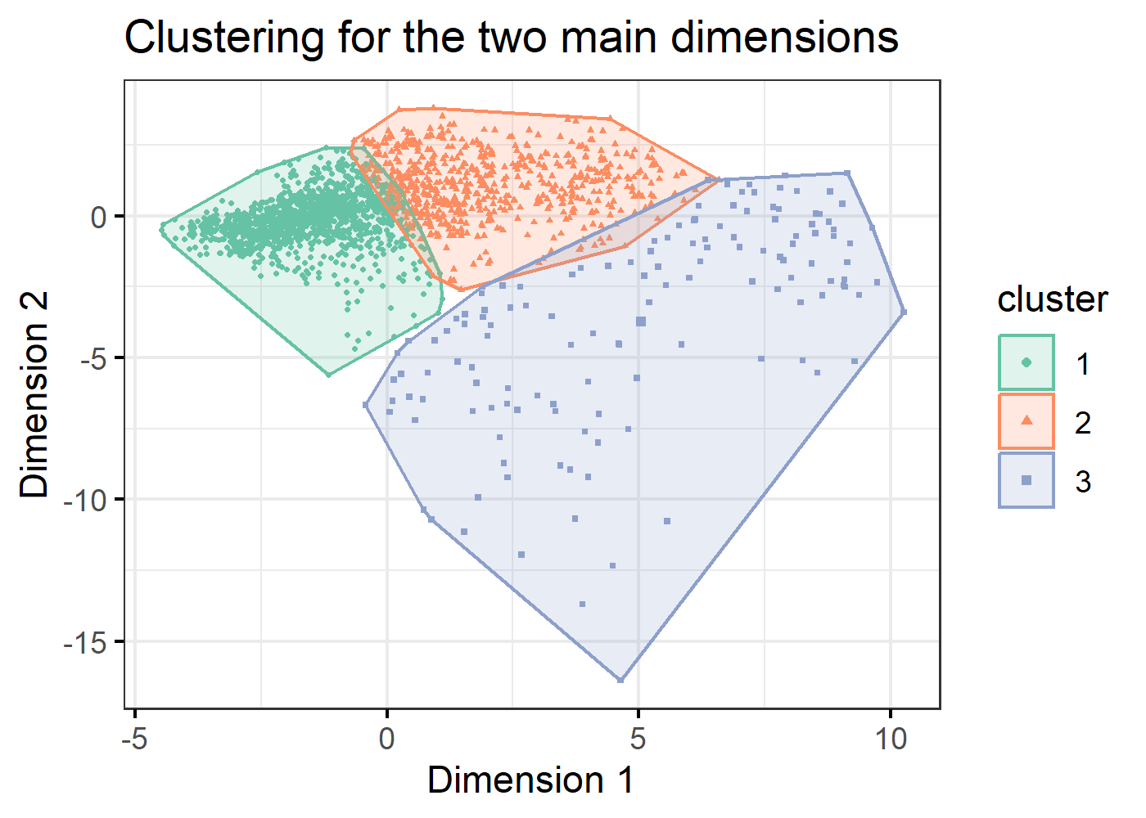
Results 2: Clustering scenario groups
C1: n = 1220,
high RE-share
C2: n = 631,
inbetween C1 & C3
C3: n = 136,
high % of conventials
T-tests between POI / No-POI not sig.

Slide 15
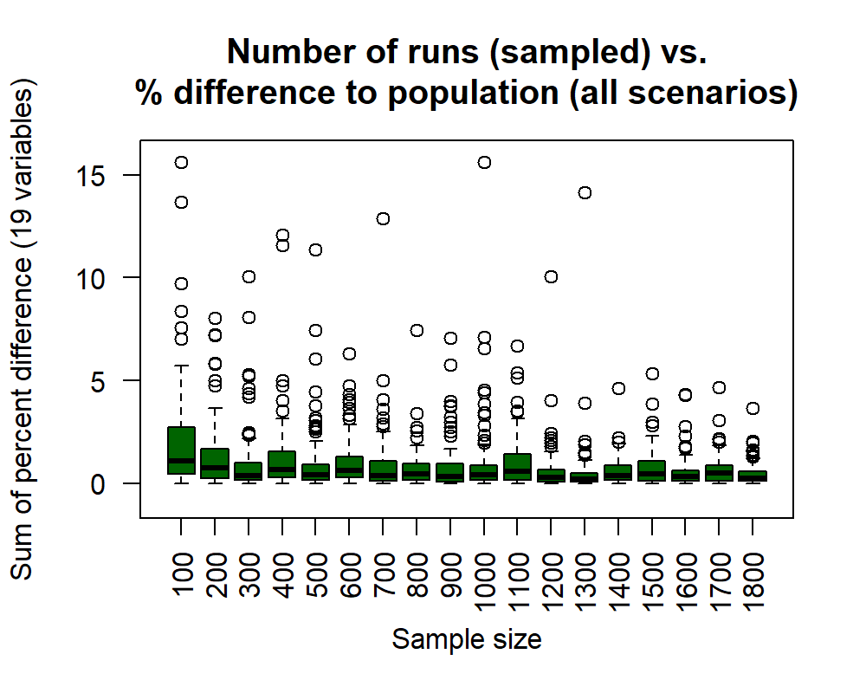
Results 3: How many scenarios do we need at all?

Slide 16
Limitations & Outlook
Limitations
  Not very ambitious scenarios
  Still LP
  Power sector only
  Cluster number is not really stable
Outlook
  Open up parameter space for more ambitious scenarios
  Introduce new indicators
  Change grid resolution

Slide 17
Conclusion
How to explore a large scenario space of future power systems: A multi-perspective analysis for Germany
Motivation: The „possibility space“
Method: Workflow on Supercomputers
Results: Best-performing scenarios

Slide 18
Thank you!
ulrich.frey@dlr.de

Slide 19
