Slide 1
Modeling District Heating Supply Patterns in a Decarbonized EU-Wide Energy System in 2050
Ali Kök⁽¹⁾, Anna Billerbeck⁽²⁾, Pia Manz⁽²⁾, Lukas Kranzl⁽¹⁾, Marcus Hummel⁽³⁾
⁽¹⁾TU Wien, ⁽²⁾Fraunhofer ISI, ⁽³⁾e-think
IEWT 2023

Slide 2
Outline
Motivation and Research Question
Methodology
Modeling chain
Hotmaps Dispatch model
Scenario design
Results
Conclusion
Next Steps
2
IEWT 2023

Slide 3
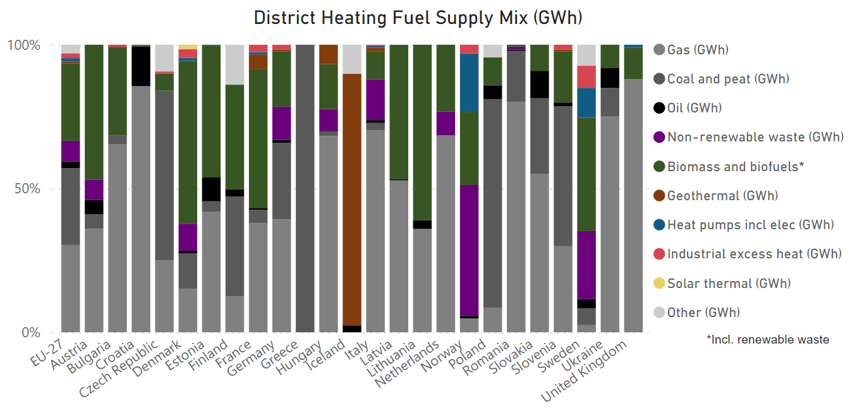
Motivation and Objective
Motivation
District Heating (DH) supply of EU-27 is highly based on fossil fuels
Research Question
Source: https://irees.de/en/2020/11/11/district-heating-and-cooling-trend-en/
What are the cost-minimal decarbonized DH generation portfolios
of EU-27 in 2050, considering:
DH grid expansion,
Availability of renewable energy source (RES) and industrial excess heat (IEH) potentials?
3
IEWT 2023

Slide 4
Methodology
The modeling chain: Comprehensive modeling of DH Ecosystem
1. Building Stock
Modeled using INVERT/EE-Lab¹
2. DH Expansion
Possible future DH areas are identified based on the distribution costs
3. RES Potential
4. DH Supply Dispatch
Modeled using the Renovation Effect tool of Hotmaps [1] and the DH expansion model of [2]
RES and IEH potentials are calculated and mapped with a high spatial resolution. Potentials are mapped with the possible DH areas [3]
DH areas are clustered into up to four groups for each MS [3]
Modeled using Hotmaps DH Dispatch module [4]
The cost-minimal DH supply dispatch is calculated for each cluster
4
IEWT 2023

Slide 5
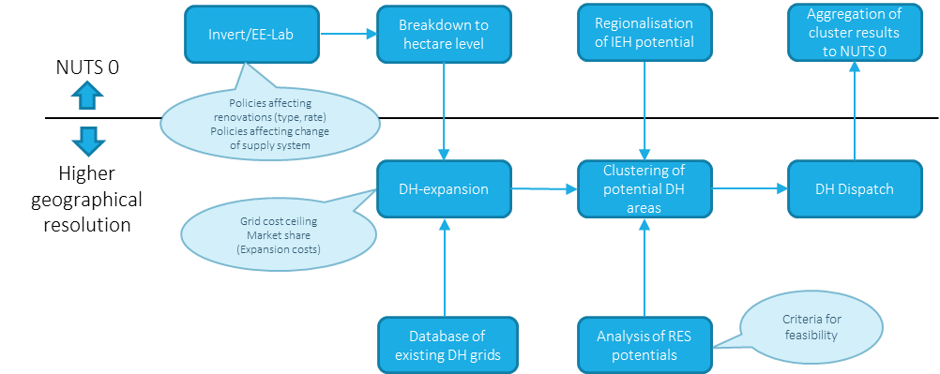
Methodology
The modeling chain: High geographical resolution
LAU regions
LAU regions
4 Clusters
LAU regions
5
IEWT 2023

Slide 6
Methodology
The modeling chain: Comprehensive modeling of DH Ecosystem
Invert/EE-Lab
Breakdown to hectare level
Regionalisation of IEH potential
Aggregation of cluster results to NUTS 0
NUTS 0
Policies affecting renovations (type, rate)
Policies affecting change of supply system
Higher geographical resolution
DH-expansion
Clustering of potential DH areas
DH Dispatch
Grid cost ceiling
Market share (Expansion costs)
Criteria for feasibility
Database of existing DH grids
Analysis of RES potentials
6
IEWT 2023

Slide 7
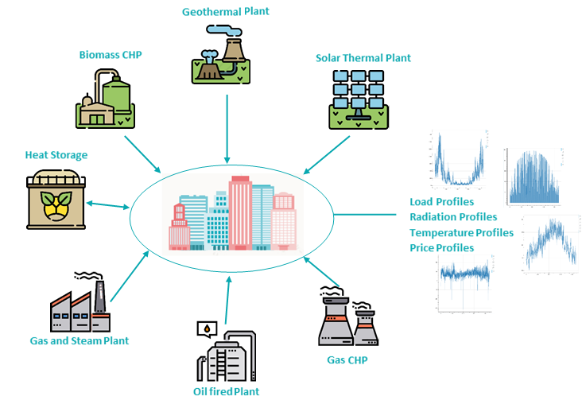
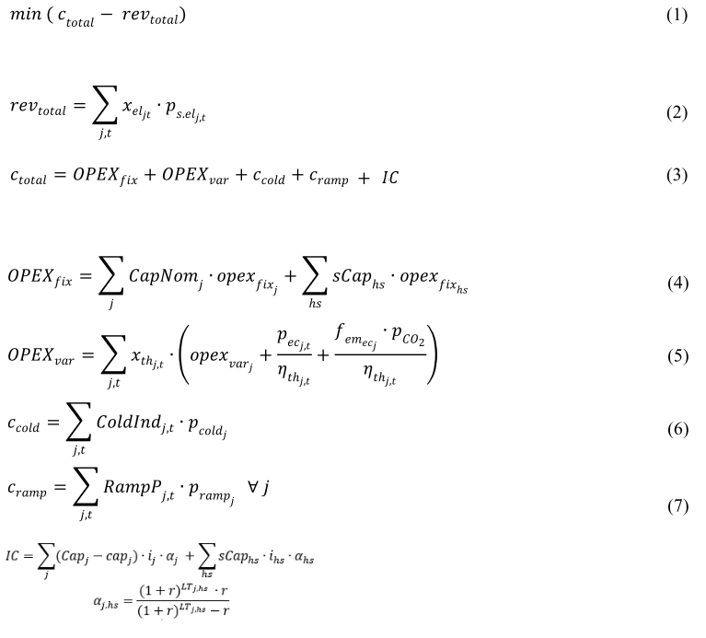
Methodology
Hotmaps Dispatch Model
Mixed-integer linear program
Minimizes (total costs - revenues)
Optimizes both investments and operation of technologies
Works on an hourly level
Efficiencies of heat pumps modeled as a function of source, flow, and return temperatures
Fixed efficiencies for all other technologies
wiki.hotmaps.eu/en/CM-District-heating-supply-dispatch
7
IEWT 2023

Slide 8
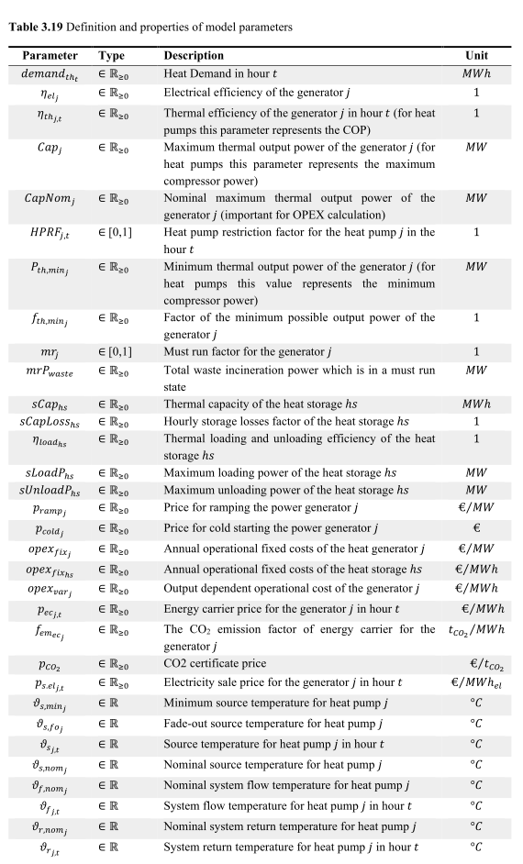
Methodology
Objective Function
Hotmaps Dispatch Model
8

Slide 9
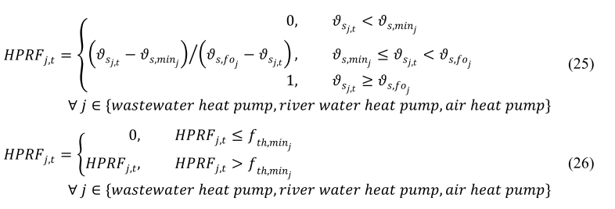
Methodology
Modeling heat pumps
9

Slide 10
Methodology
Main Assumptions: 2050
Greenfield investment optimization → nothing exists at the beginning
Pre-installed capacities for Waste to Energy (WtE) plants
RES and industrial excess heat potentials → upper limit for heat generation
Technoeconomic data based on the ENER/C1/2018-494¹ project
Country and size-specific
Energy carrier prices (incl. taxes and fees) and emission factors based on the ENER/C1/2019-481 project
Hydrogen: country-specific, 148 €/MWh on average
Electricity: hourly and country-specific, 127€/MWh on average
Biomethane: country-specific, 108 €/MWh on average
Depreciation time = lifetime of plants
Interest rate = 2%
Biomass: 35 €/MWh, IEH: 10 €/MWh, and CO2 price: 500 €/tCO2
waste: 0 €/MWh → also 0 emission factor
10
IEWT 2023

Slide 11
Methodology
Main Assumptions
Insert heat pump temperature sensitivities
Insert temperature sensitivity of geothermal potentials → the temperature thresholds?
Insert energy carrier prices in a table? → we have country-specific prices
11
IEWT 2023

Slide 12
Methodology
Technologies
Natural gas boiler
Natural gas CHP
Biomass boiler
Biomass CHP
WtE CHP
Air source heat pump
River water & lake heat pump
Wastewater heat pump
Solar thermal
Industrial excess heat (direct)
Geothermal direct (hydrothermal)
Geothermal direct (petrothermal)
Hydrogen boiler
Hydrogen CHP
Biomethane boiler
Heat storage
12
IEWT 2023

Slide 13
Methodology
Scenario Design: System Temperatures
Two main scenarios:
High temperature
Flow temperature: 95-85°C
Return temperature: 60°C
Low temperature
Flow temperature: 65-55°C
Return temperature: 30°C
Sensitivity:
High geothermal investment cost → 100% increase
Dispatch: has a direct impact only on heat pumps
Indirect impact through potentials
13
IEWT 2023

Slide 14
Results: EU-27
Heat Generation
Low temperature
TWh
TWh
High temperature
TWh
TWh
Moderate Geothermal Investment Cost
High Geothermal Investment Cost
14
IEWT 2023

Slide 15
Results
Heat Generation
Low temperature
TWh
TWh
High temperature
TWh
TWh
Moderate Geothermal Investment Cost
High Geothermal Investment Cost
15
IEWT 2023

Slide 16
Results: EU-27
Levelized Cost of Heat Full Load Hours
Low temperature
High temperature
16
IEWT 2023

Slide 17
Conclusions
Heat pumps and geothermal could play an important role in the decarbonisation of the European DH sector
Natural gas is phased out with a carbon price of 500€/tCO2
Clear impact of system temperatures on the DH supply mix
Heat pumps have a significant share in DH supply in all scenarios
Air source HPs are relevant in both temperature scenarios
Waste-water HPs play a more important role in high-temperature scenario
River water & lake HPs only in low temperature scenario
Geothermal has the highest share in heat generation in the low-temperature scenario
Geothermal might partly replace heat pumps in the low-temperature scenario
Share reduced by more than 50% in case of high investment costs
Petrothermal is not in the supply mix anymore
Biomass depends on policy choices regarding biomass allocation and stringency of sustainability criteria according to the Renewable Energy Directive
17
IEWT 2023

Slide 18
Next steps
Sensitivity and MS-level in-depth analyses
Analyzing results in MS-level
Analyzing the exploitation of potentials
Sensitivities
Carbon price / positive emission factor for waste
Policies on electricity price: no/lower tax for heat pumps
Price variations for biomass
Which further parameter variations/sensitivities would you suggest?
18
IEWT 2023

Slide 19
Thank you for your attention!
Questions?
koek@eeg.tuwien.ac.at
19
IEWT 2023

Slide 20
References
[1] https://www.hotmaps.eu/
[2] Fallahnejad, M., Kranzl, L., & Hummel, M. (2022). District heating distribution grid costs: a comparison of two approaches. International Journal of Sustainable Energy Planning and Management, 34, 79–90. https://doi.org/10.54337/ijsepm.7013
[3] Manz, P., Billerbeck, A., Kök, A., Fallahnejad, M., Fleiter, T., Kranzl, L., Braungardt, S. (2023). Renewable and excess heat potentials for climate-neutral district heating in Europe: GIS and clustering algorithm based approach. To be submitted.
[4] https://github.com/tuw-eeg/hotmapsDispatch/tree/reshc_pathways
20
IEWT 2023

