Slide 1
13. Internationalen Energiewirtschaftstagung, Die Zukunft der EnergieMÄRKTE in Europa vor dem Hintergrund neuer geopolitischer Ungleichgewichte
Nötige Investitionsverlagerungen in Europas Infrastruktur für das Erreichen von Netto-Null-Pfaden
Based on: Klaaßen, L., Steffen, B. Meta-analysis on necessary investment shifts to reach net zero pathways in Europe. Nature Climate Change. 13, 58–66 (2023). https://doi.org/10.1038/s41558-022-01549-5
Presenter: Lena Klaaßen (Climate Finance and Policy Group led by Prof. Bjarne Steffen, ETH Zurich)
16th February 2023, Vienna/Austria
This project has received funding from the European Union's Horizon 2020 research and innovation programme, European Research Council (ERC) under grant agreement No. 948220, Project No. GREENFIN.
Notes:
Thanks and pleasure to be here
Project is funded by the European Union through an ERC starting grant
Paper emerging from the project has been very recently in Nature Climate Change
→ Show also many results from the paper

Slide 2
Research question and methods

Slide 3
Meta-analysis of financing needs for Europe’s infrastructure until 2035 Research question and methods
Research question: What specific investment shifts for Europe’s energy and transport infrastructure are required over the next 15 years to get on a path toward net zero?
Meta-analysis based on data points from
(1) 18 academic studies (peer-reviewed)
(2) 15 studies from governments or international organizations (IOs)
(3) 23 studies from industry
We calculate technology-specific investment needs aligned with
(1) the former EU GHG emission reduction target (-40% by 2030 and -80% by 2050 below 1990 levels) → “Baseline EU target”
(2) the increased EU GHG emission reduction target (-55% by 2030 and -100% by 2050 below 1990 levels) → “New EU target”
Comparing these investments to past investments, we derive the required investment shifts
Notes:
Read RQ
Many previous studies
focused largely on power generation
Were not very granular technology wise
Did not convert capacity additions into financing needs
Did not put results in context to past investment levels
Meta-analysis → made studies from academia, governments/international organizations and industry comparable

Slide 4
Necessary infrastructure investment shifts

Slide 5
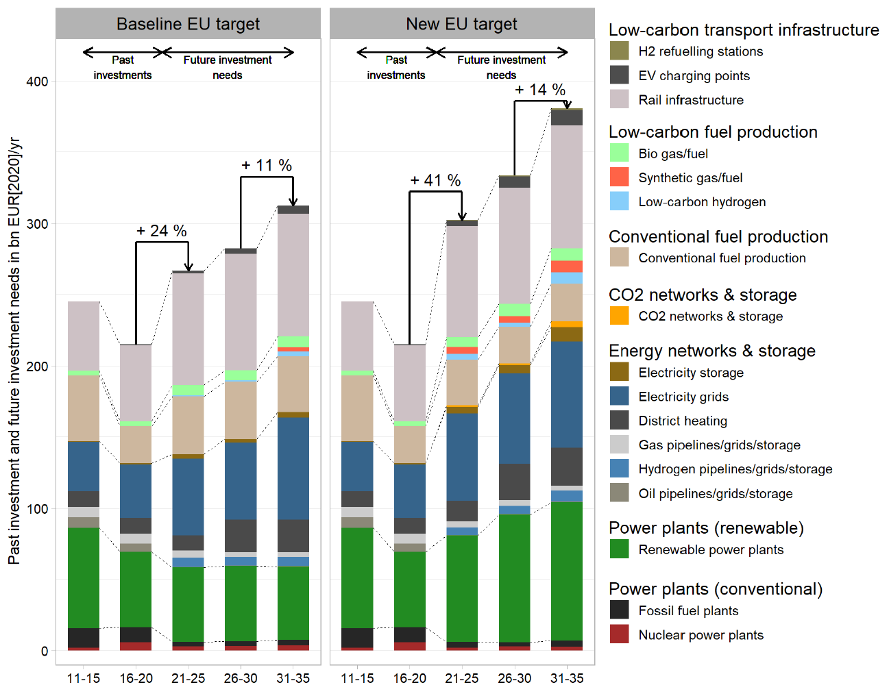
Fit-for-55 EU target implies a steep uptick in investment needs Past investments and future infrastructure investment needs for Europe
Source : Klaaßen, L., Steffen, B. Meta-analysis on necessary investment shifts to reach net zero pathways in Europe. Nature Climate Change. 13, 58–66 (2023).
Notes:
Steep increase (+EUR 90 bn/yr) in total investment needs compared to past levels
Needs to happen as of now → ambitious, but overall investment volumes are on a feasible level and have also been higher in the past
Biggest investment needs are for renewable power plants (green), electricity grids (blue), rail infrastructure
But also new technologies are joining the mix → electricity storage, low-carbon fuels, CO2 network & storage

Slide 6
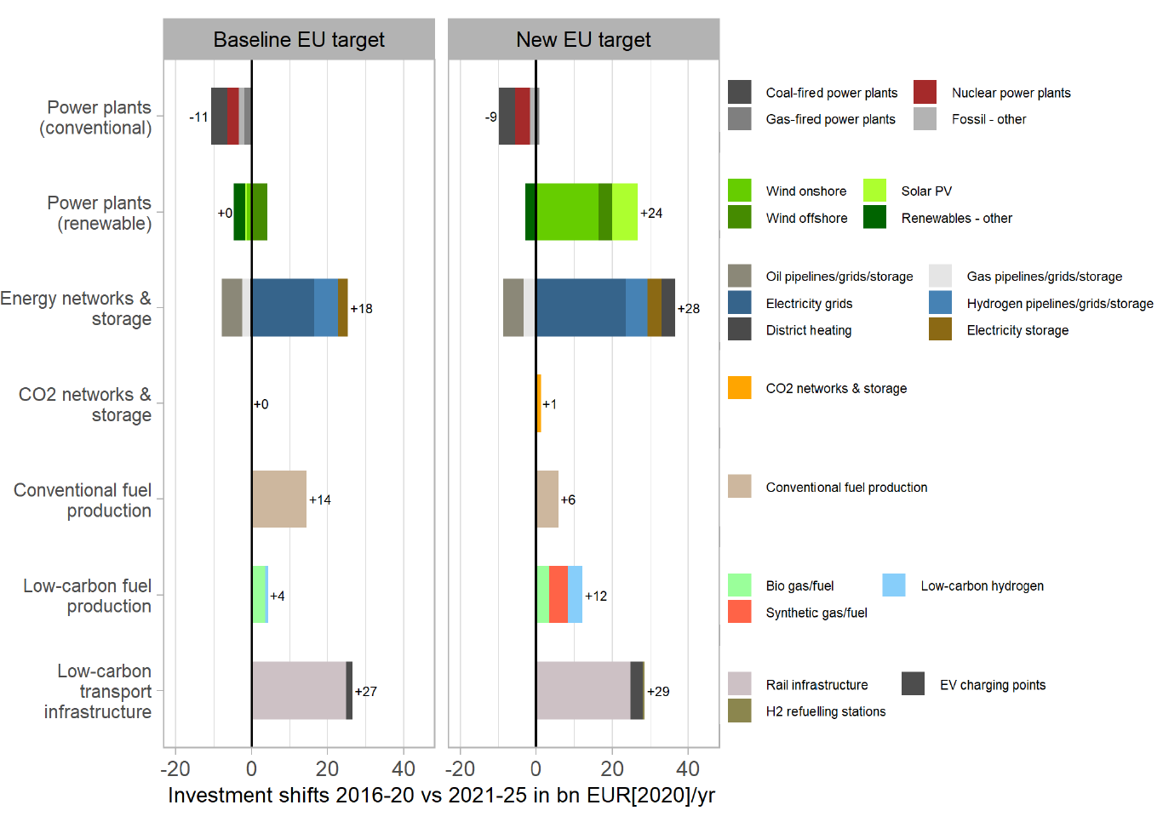
Invests in renewables, electricity grids, low-carbon fuels to grow rapidly Investment shifts required between 2016–2020 and 2021–2025
Source : Klaaßen, L., Steffen, B. Meta-analysis on necessary investment shifts to reach net zero pathways in Europe. Nature Climate Change. 13, 58–66 (2023).
Notes:
Same numbers presented in a different way with focus on the required shifts
Divestment need in fossil fuel stays on the same level as for the baseline EU target
But strong increase in renewable power plants
Significant increase in electricity grids and rail infrastructure

Slide 7
Confidence of estimates

Slide 8
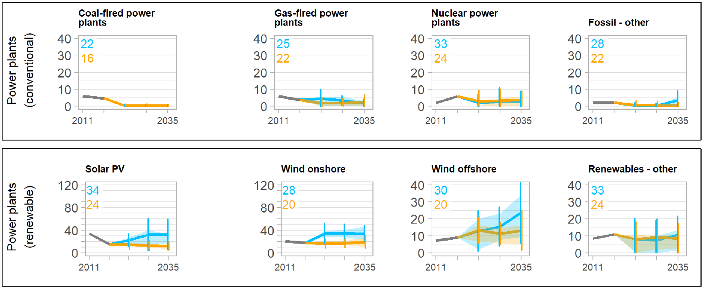
For power generation, uncertainty rather low (except offshore wind) Spread of investment needs (1/3)
Source : Klaaßen, L., Steffen, B. Meta-analysis on necessary investment shifts to reach net zero pathways in Europe. Nature Climate Change. 13, 58–66 (2023).
Notes:
Confidence of estimates for power generation technologies
- Fit for 55 is represented by the blue color
Thick line represents the mean and the shaded area the interquartile range and the vertical line the standard deviation
The numbers in the upper left corner show the numbers of estimated considered
All in all, we see that the uncertainty is rather low; except from offshore wind

Slide 9
High magnitude of electricity grid investments also broadly shared Spread of investment needs (2/3)
Source : Klaaßen, L., Steffen, B. Meta-analysis on necessary investment shifts to reach net zero pathways in Europe. Nature Climate Change. 13, 58–66 (2023).
Notes:
High magnitude and upwards trend for electricity grids is broadly shared → also over the entire IQR
While e.g. for hydrogen infrastructure the IQR ranges from almost zero to 7-8 bn euros per year → still undecided which role hydrogen will excactly have in a low-carbon economy

Slide 10
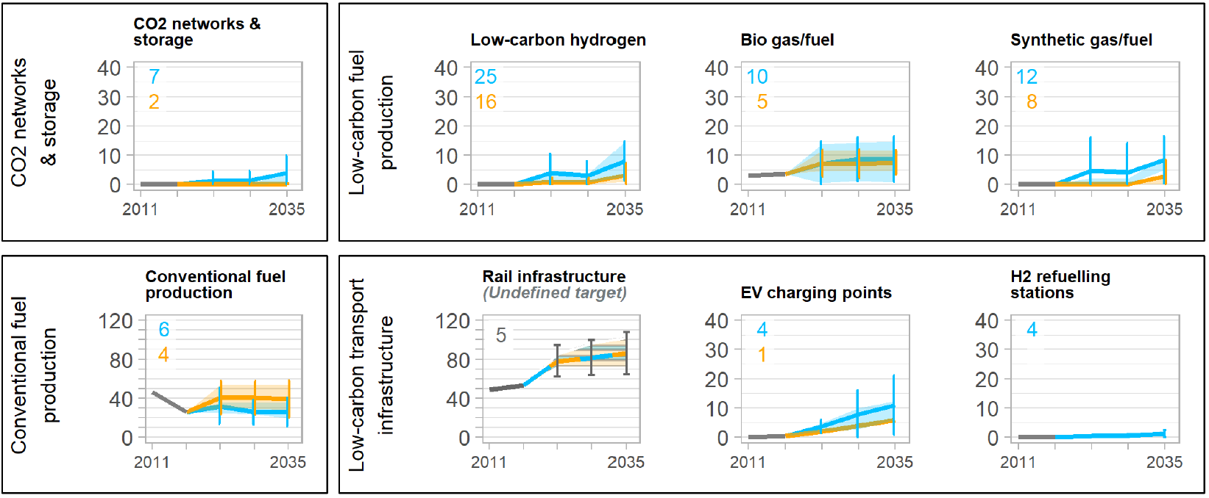
Less (and diverse) evidence on low-carbon fuels, hydrogen, rail infra Spread of investment needs (3/3)
Source : Klaaßen, L., Steffen, B. Meta-analysis on necessary investment shifts to reach net zero pathways in Europe. Nature Climate Change. 13, 58–66 (2023).
Notes:
Confidence of estimates for the remainder of the technologies in scope

Slide 11
Differing views government/industry/academia

Slide 12
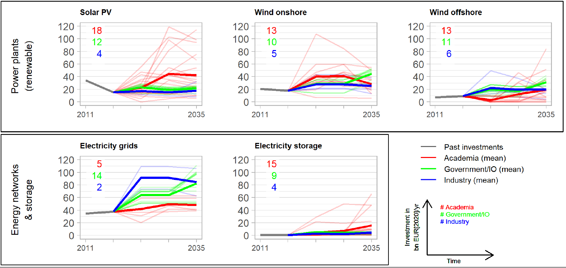
No major differences between government and industry studies Time series and means by type of institutions for key technologies (new EU target)
Note: IO = International organization (e.g. the EU)
Source : Klaaßen, L., Steffen, B. Meta-analysis on necessary investment shifts to reach net zero pathways in Europe. Nature Climate Change. 13, 58–66 (2023).

Slide 13
Impacts of Russia-Ukraine war

Slide 14
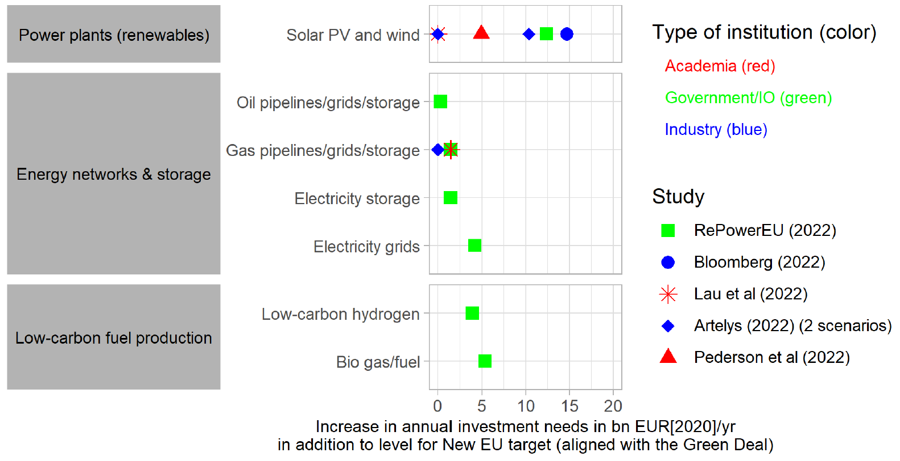
Independence from Russian gas increases especially solar & wind invest Increase in annual investment needs in addition to level for new EU target
Source : Klaaßen, L., Steffen, B. Meta-analysis on necessary investment shifts to reach net zero pathways in Europe. Nature Climate Change. 13, 58–66 (2023).

Slide 15
Conclusions

Slide 16
High confidence for steep uptick in investment needs in infrastructure Conclusions
Our results show a steep uptick in overall investment needs over the next 15 years with high confidence, mandating timely policy action to induce timely investment shifts
The fact that even a shock like the Russia–Ukraine war does not fundamentally change the picture supports this notion
Our results highlight the need for more assessments of investment needs, also beyond power generation

Slide 17
Thank you! Contact: Lena Klaaßen Climate Finance and Policy Group ETH Zurich lena.klaassen@gess.ethz.ch

