Slide 1
Validation of modeling smart energy management systems in reduced order models with building simulation models
Philipp Mascherbauer, Daniel Heidenthaler, Lukas Kranzl
16.02.2023

Slide 2
Contents
Background
Model
Method
Buildings
Results
Conclusion + Outlook

Slide 3
Background
This project has received funding from the European Union's Horizon 2020 research and innovation programme under grant agreement no. 893311.
newTRENDs: New Trends in Energy Demand Modelling
How much electricity load can the current building stock shift?
How do societal trends impact the overall electricity consumption?
Model:
Using the day-ahead price to incentivize buildings with heat pumps to shift load
Minimizes the energy costs based on the day-ahead price
Calculates the hourly heating and cooling demand for representative buildings in the building stock.
Thermal mass of the building is used as storage.
Use 5R1C approach to represent buildings to reduce complexity
Will an economic optimization of a building with a reduced order model also result in lower costs in a dynamic building simulation?
Notes:
Societal Trends include work from home, but also increase in PV panels, or heat pump uptake in the future.

Slide 4
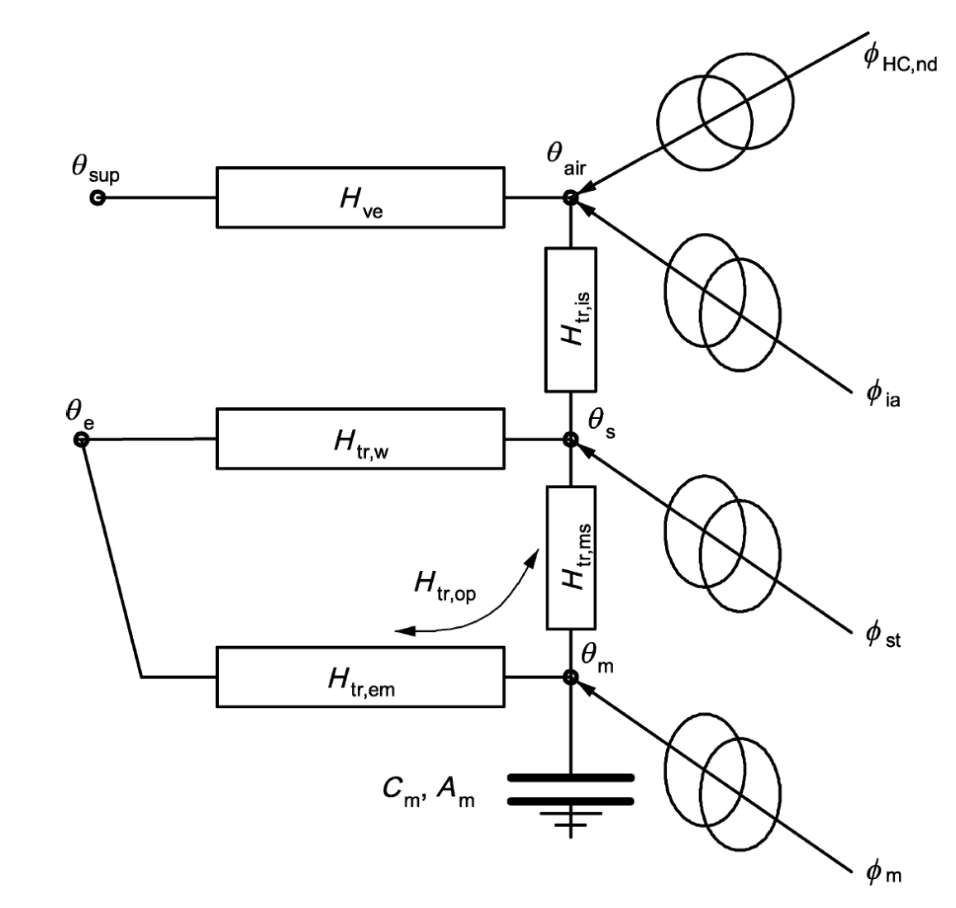
Objective
Model
Method
Results
Conclusion
5R1C Model
Hourly heating demand is calculated with a 5R1C approach
(DIN ISO 13790)
Input:
Building parameters
Indoor temperature bandwidth
Heating system
Hot water demand
Weather data
Electric load
Electricity price
Output:
Load profiles
Operation costs
Indoor temperature

Slide 5
Method
5R1C model:
$$\min{Cost}=\sum_{t=1}^{8760}{P_{t}∗E_{t}}$$
Optimization
Heat demand + Costs
Indoor temperature profile
9 Buildings
Indoor set temperature
comparison
Heat demand + Costs

Slide 6
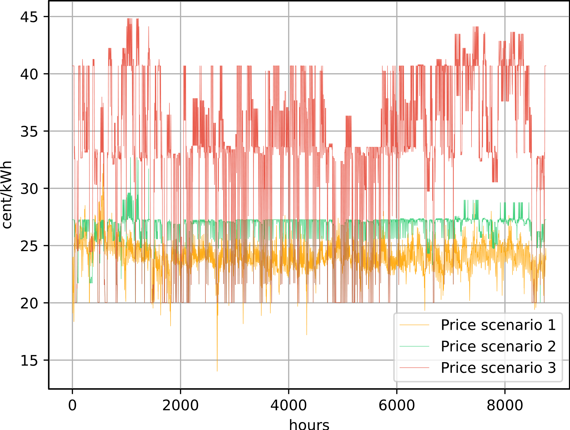
Electricity price
Price 1: spot market price 2019 [1] + 20 cents/kWh
Price 2, 3: Scenario prices from Balmorel [2] with CO₂ price:
Price 2: 53 €/tCO₂
Price 4: 212 €/tCO₂

Slide 7
Buildings
SFH
MFH
Specific thermal mass
Good insulation
Medium insulation
Bad insulation

Slide 8
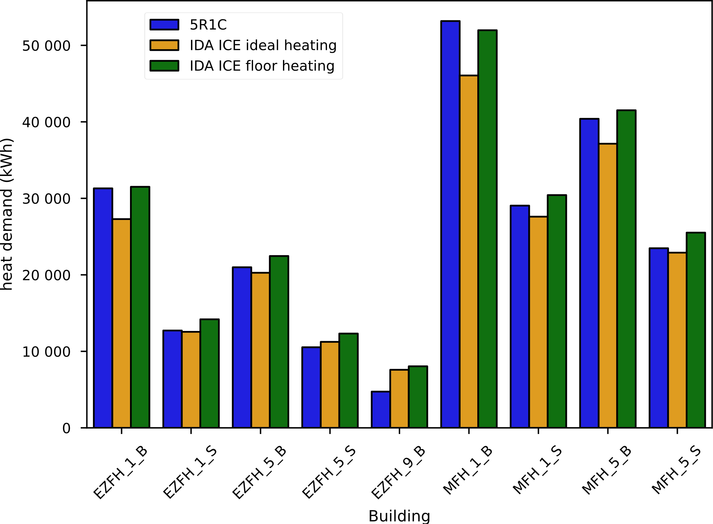
Yearly heat demand
Heat distribution system has no losses
Notes:
Heating demand is slightly overestimated, better when comparing with floor heating (losses etc.)

Slide 9
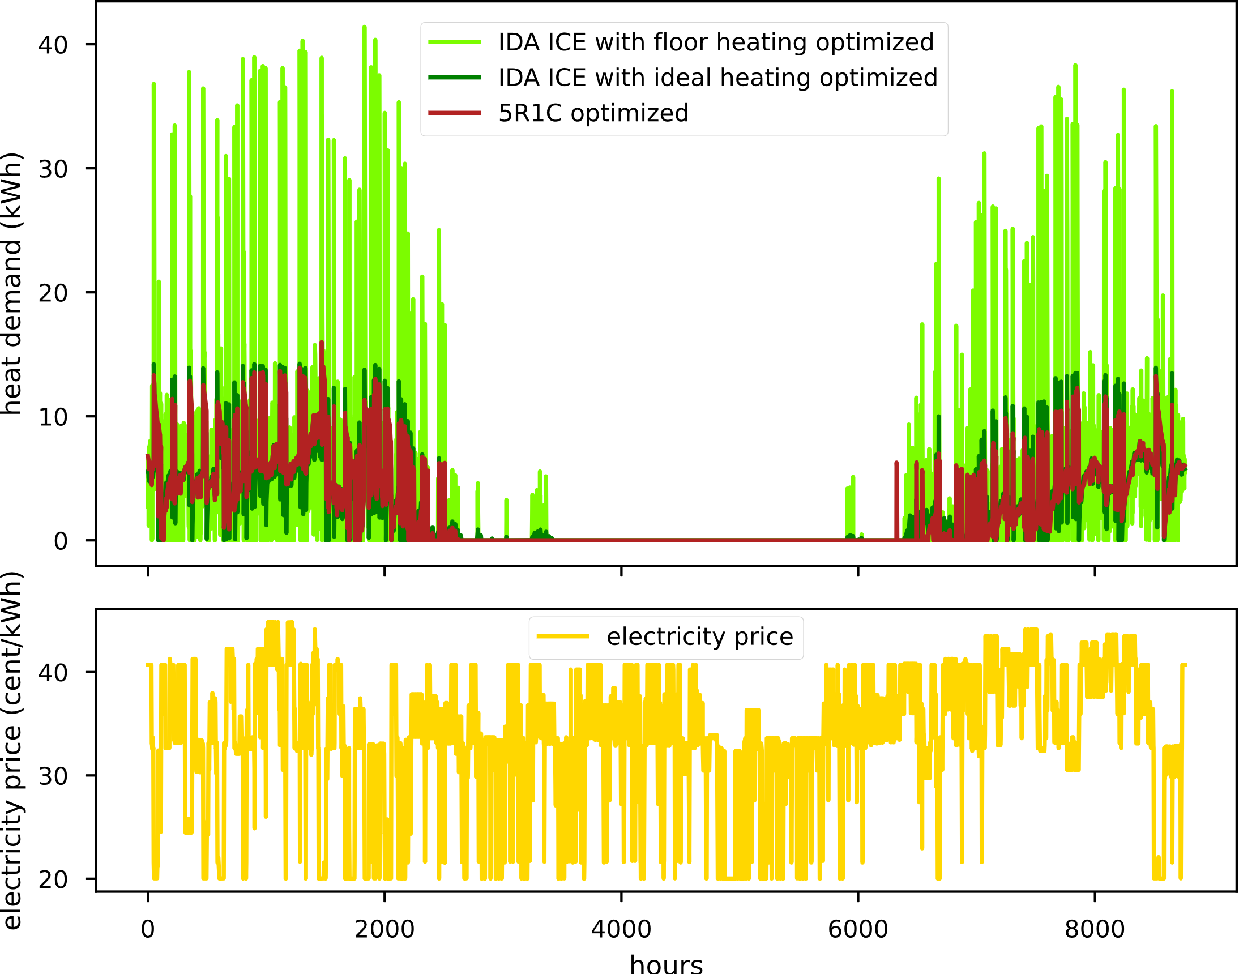
Hourly heat demand due to smart energy management
EZFH_5_B
Notes:
Dadurch dass das die Innenraumtemperatur vorgegeben wird, muss das Haus mit Bodene´heizung viel mehr Energie in einer Stunde auf bringen wenn vorgeheizt wird. Dafür sinkt der Energieverbrauch in den folgenden Stunden umso stärker (was mit dem 5R1C nicht abgebildet wird).

Slide 10
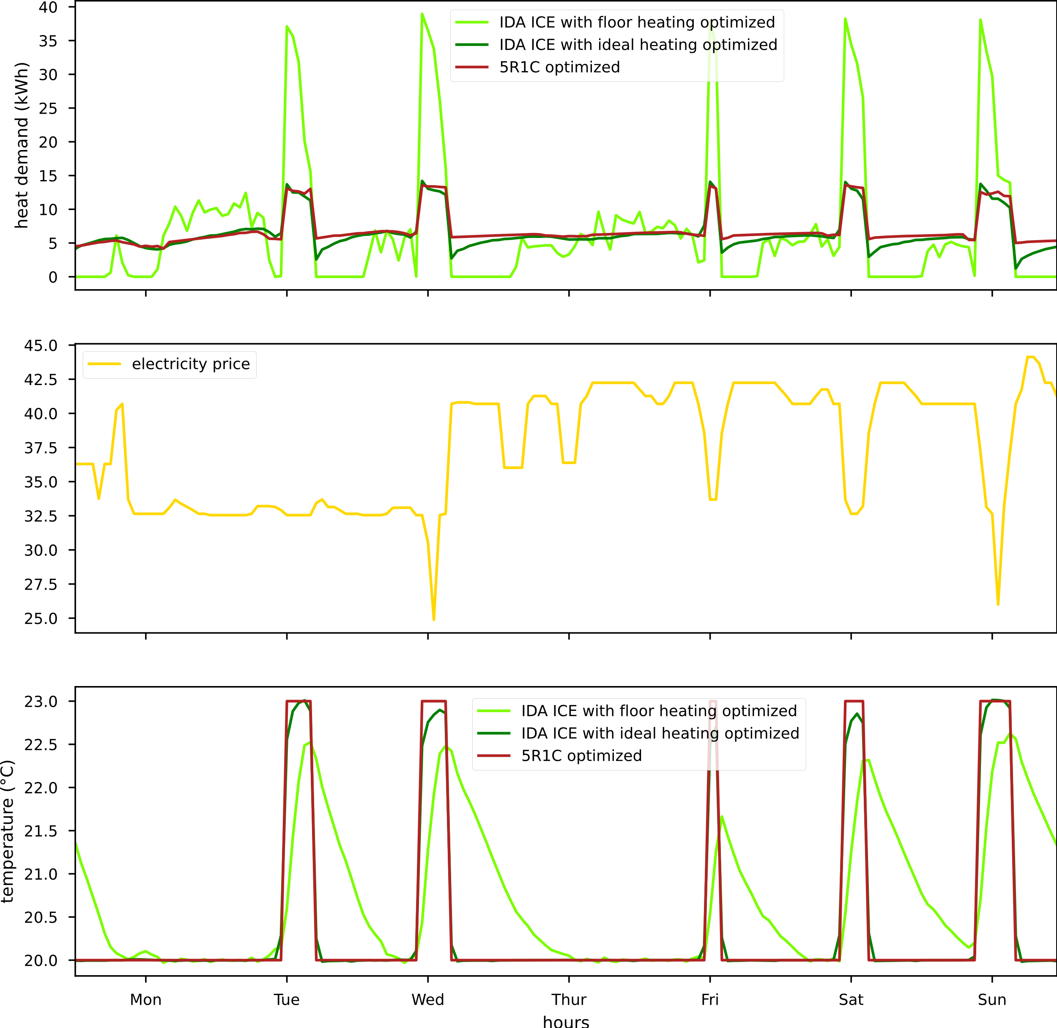
Hourly heat demand due to smart energy management

Slide 11
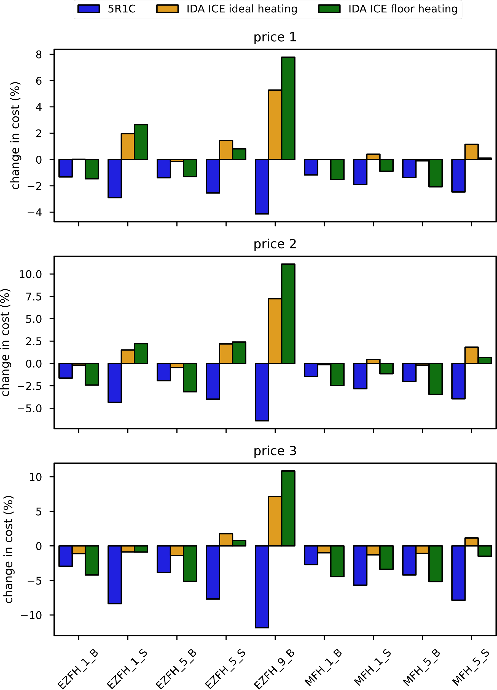
Relative change in heating cost due to optimization
Through floor heating much more demand can be shifted than calculated by the 5R1C model
As a result cost reduction calculation is less accurate

Slide 12
Conclusion + Outlook
The 5R1C model estimates the heating demand well for bad insulated buildings
Heating demand for light weight and well insulated buildings is underestimated by the 5R1C model
The 5R1C approach underestimates the inertia of the floor heating system and thus the costs of introducing smart energy management systems
This is most relevant for light weight buildings with low specific energy demand
Outlook:
Update the model to better estimate the high inertia of floor heating systems
Include cooling

Slide 13
Thank you for your attention!
Philipp Mascherbauer
mascherbauer@eeg.tuwien.ac.at

